Slide 1
The Great Gatsby: How is the story told in chapter 4?
Destination:
What story is being told in chapter 4, and what is its significance to the text as a whole?
Plot outline/sequence of events
Main themes/issues/ideas
Does the chapter develop previous/anticipate later events/themes?

Slide 2
Symbolic importance of time and/or place (and/or setting)
Nick lists names at opening: symbolically important, because…
As well as being reminded of the class symbolism encapsulated by the East Egg-West Egg division, we are reminded briefly of the importance of:
the valley of ashes (p. 66)
cultural capital of Oxford (Gatsby’s story; Wolfsheim’s mention of it; Nick’s question [p.67])
the view of the city as they approach it (p. 67)
the limousine that passes as they approach the city

Slide 3
Development/use of character and use of narrative voices
Gatsby tells his story (Nick still frame narrator)
Do we believe Gatsby’s history?
Gatsby like a “character” (p.64)
“I didn’t want you to think I was just some nobody” (p.66): prolepsis to confrontation with in ch. 7, p. 123)
Nick takes on Jordan’s voice to tell history of D & G
Structural significance of this narrative device? (Looks forward to use of Michaelis in ch. 7)
Gatsby “came alive” for Nick (p. 76)
Wolfsheim: what does this tell us…
about Gatsby?
about consumption and corruption/authenticity?

Slide 4
Gatsby: How is the story told in chapter 5?
Destination: What story is told in chapter 5, and what is its significance to the text as a whole?

Slide 5
Destination
Gatsby and Daisy reunited
We see something of the “truth” of Gatsby(?)
Nick’s infatuation with Gatsby (and Daisy?) is reasserted (end’s with Nick’s rejection by Gatsby and Daisy?)

Slide 6
Time
Significance of the clock when Gatsby and Daisy are reunited

Slide 7
Location/Setting
Opening (image of fire)
Gatsby’s mansion looks like “the World’s Fair”
Use of sun/rain/weather (pathetic fallacy)
G & D “truly” reunited “off-stage”
Nick’s grass (p. 85): “Once more it was pouring…”
Detailing of Gatsby’s mansion and its contents
Green light (p.90)

Slide 8
Characters & voice
Adverbs used to describe Gatsby early in chapter
Presentation/description of Gatsby (pale, ghostly), and what he says (“It’s too late”), contrast with description after reunion (linked to pathetic fallacy)?
Descriptions of Daisy’s voice (song-like: links to songs sung towards end?)

Slide 9
Intertextuality
Castle Rackrent
Kant
Songs at end

Slide 10
Feedback: How is the story told?
Responses generally good for first attempts.
Grade boundaries low and tight (when calculated for individual questions): 2 marks between grades (equivalent) for this question
13 = A
11 = B
9 = C
7 = D
5 = E

Slide 11
Strengths
Points made generally relevant
Understanding of chapter generally (very) good
Most points supported; but if not, target is to use quotation/specific reference at all times

Slide 12
To improve:
Significance of points not always clearly/precisely stated (sometimes not at all; sometimes very general/vague)
Points not always explicitly linked back to significance to chapter/whole text
Points not always clearly linked to Fitzgerald’s narrative method/technique/“craft”

Slide 13
Avoid vagaries or “half” points:
“This foreshadows later events.”
“The yellow and blue is important because it is prolepsis.”
“The lacunae suggest that Nick is controlling what the reader knows, and suggest that he is keeping something from us.”

Slide 14
Safest to use building blocks as guide, and to make other literary/linguistic techniques parts of these. E.g.:
The story is developed through the symbolism of place. Chapter II opens with a vivid description of the “valley of ashes,” which, significantly, is located “about half way between West Egg” (which represents “old-money” wealth) “and New York”, which itself is symbolic of modern capitalism and the logic of conspicuous consumption. The valley of ashes is described alliteratively as “a fantastic farm” in which everything, including, its people appear to be crumbling. Nick’s description of the valley of ashes depicts the dying, or “crumbling”, of industrial capitalism; and with this image Fitzgerald encapsulates one of the novel’s central themes: class divide, between rich and poor, new money and old money (symbolised by the East and West divide). It is a theme that Fitzgerald further develops through Nick’s presentation of Myrtle, and the party scene later in chapter II.
Narrative method/aspect identified (place and symbolism)
Focussed quotations used as support
Other linguistic features mentioned (alliteration)
Focus on structure (valley connects different settings/locations) as well as language
Comments linked to Fitzgerald’s narrative technique, to the text as a whole, and to further developments in the chapter.
Ending is fine as long as you use it to set up subsequent paragraph(s)
Approx. 130 words.

Slide 15
How is the story told in chapter VII?
Review chapter VII:
What is its significance to the novel as a whole?
Which are the most significant aspects of the narrative (think in terms of the “building blocks”)?

Slide 16
How is the story told in chapter VIII?
What story is being told?
What is the significance of this chapter to the novel as a whole?
Which “building blocks” would you focus on if this chapter came up in the exam?
Look at the opening at the ending of the chapter:
What happens/what is depicted?
Which “building blocks” would you nominate in order to comment on the opening and the ending?
Do you notice any patterns (in terms of openings/closings of other chapters?)

Slide 17
Several chapters begin with setting/place
Why?
Which setting(s) is of central importance to this chapter?
Several chapters end with a character being isolated
Which ones?
Why might this be significant?
Which characters would you focus on for this chapter?

Slide 18
Time
In what ways/senses does time feature importantly in this chapter?
Gatsby relives his past with Daisy (by telling Nick his story)
Nick completes the timeline from the crash through to Gatsby’s death: so the chronology of ch. VIII overlaps with that of ch. VII
How does Nick know/find out all this?
Nick’s chronology makes repeated reference to clock time; this gives the sense of being more objective/factual (whereas before he has taken a more speculative/hermeneutic approach?)
E.g. speculating as to the significance of the green light for Gatsby (ch. V)
E.g. speculating as to Daisy’s feelings for Gatsby in the retelling of their past (ch. VIII)
There are simultaneous chronologies/timelines: we realize retrospectively (by the end of the chapter) that as Nick and Gatsby talk during dawn and into the morning, Wilson is making his way towards Gatsby’s mansion

Slide 20
Method/technique/aspect of narrative | Where in the chapter | Quote/reference

Slide 21
Method/technique/aspect of narrative | Where in the chapter | Quote/reference

Slide 22
Gatsby: Section A, even numbers
Some readers are irritated by Nick Carraway as a narrator. What is your view of Fitzgerald’s use of Nick Carraway as a narrator? (21 marks)

Slide 24
Notice that you are not assessed on AO2.
However, the examiners are expected interpretations to be supported (AO3)
This is also the only question in which you are expected to comment on context (AO4)

Slide 25
Reasons for agreeing/disagreeing.
Present in a grid/list
How would you bring context into your response?

Slide 26
The examiners said…
Possible content:
Comment might be made about
Nick’s unreliability
the way Nick filters the story
the focus that Fitzgerald’s use of Nick places on narratives themselves [modernist literature]
the interest Nick creates as a participant narrator
the way Nick reveals Gatsby
the way Nick romanticises Gatsby
the way Nick acts as a commentator on the other characters
the way Nick acts as a moraliser on the American Dream
the way Nick is used to create the illusion that we are reading about the people, etc.
Good answers will have a clear sense that Fitzgerald has chosen this particular narrator who is Nick Carraway.

Slide 28
How appropriate do you think it is to describe The Great Gatsby as a tragedy? (21 marks)

Slide 29
AO3, AO4: the focus that Fitzgerald’s use of Nick places on narratives themselves. [Can you find quotes to fill the gaps?]
If readers are irritated by Nick, it is likely to be because of his apparent unreliability or inconsistency. However, it is important to note that Nick is consistently inconsistent; he makes this clear in the opening passages of the book, when he tells us that… We must also remember that it is Fitzgerald the author who constructs his narrator in this way, and that in doing so he reminds us of the inherent unreliability – or, perhaps, subjectivity – of writing. From the beginning, Nick reminds us that what we are reading is very much a story (…), and at the end, he reminds himself: “I see now that this has been a story of the West, after all”. Such self-reflexive moves was not uncommon among modernist writers like Fitzgerald, who often saw language as subjective and creative rather than objectively reflective.

Slide 30
Tragedy: Aristotle
Genre that ends in the fall (often but not always death) of the protagonist that incorporates themes of violence and revenge, order and disorder
Imitation, or mimesis, of an action that is serious and complete, and which excites the emotions of pity and fear in the audience, causing catharsis. Its action should be single and complete presenting a reversal of fortune, or peripeteia, which is then resolved through anagnorisis (recognition or revelation), involving persons who are held in great esteem and it should be written in language made pleasurable.
The protagonist should be of noble birth, and their error in judgement is known as hamartia.
Hamartia is usually brought about by the protagonist’s arrogance and failure to heed warnings. This is known as hubris.
Arthur Miller: “Tragedy and the Common Man.”

Slide 31
How far do you agree with Nick’s view that Gatsby is “worth the whole damn bunch put together”?

Slide 32
How far do you agree with Nick’s view that Gatsby is “worth the whole damn bunch put together”?
Review (in note form):
Which AOs are assessed in this question (Section A, part II), and what are the AOs?
How does this question differ from “How is the story told?”

Slide 33
AOs
AO1
Quality of writing; focus on question
AO3
Interpretations/alternative interpretations; supported by references to text
AO4
Context
Section A, part I: AO2 only

Slide 34
How far do you agree with Nick’s view that Gatsby is “worth the whole damn bunch put together”?
Things to consider:
- How do we attach “value”/“worth” to a person?
- Is Nick’s attitude/valuation of Gatsby consistent throughout the novel? If not, how/why does it change?
How do others view/value Gatsby?
- Which sections/moments of the novel will you need to refer to answer this question?

Slide 35
The examiners said…
Agree
Disagree
Gatsby’s capacity to love
his capacity to wonder and dream
his romance
his human decency
his mystery
the way other characters are so shallow
what “worth” actually means in terms of friendship and love (from Nick), etc.
his corruption
the way Nick is fooled and intoxicated by a false glamour
his adultery
his immorality
the fact that Myrtle Wilson is a victim and Gatsby does not mourn her death
his absurd obsession with a worthless woman
his naivety, etc.

Slide 36
Plan responses, working in the following groups:
How far do you agree with Nick’s view that Gatsby is “worth the whole damn bunch put together”?
** Pay particular attention to AO4 **

Slide 37
The examiners said…
Agree
Disagree
Gatsby’s capacity to love
his capacity to wonder and dream
his romance
his human decency
his mystery
the way other characters are so shallow
what “worth” actually means in terms of friendship and love (from Nick), etc.
his corruption
the way Nick is fooled and intoxicated by a false glamour
his adultery
his immorality
the fact that Myrtle Wilson is a victim and Gatsby does not mourn her death
his absurd obsession with a worthless woman
his naivety, etc.

Slide 38
AO3, AO4: the focus that Fitzgerald’s use of Nick places on narratives themselves. [Can you find quotes to fill the gaps?]
If readers are irritated by Nick, it is likely to be because of his apparent unreliability or inconsistency. However, it is important to note that Nick is consistently inconsistent; he makes this clear in the opening passages of the book, when he tells us that… We must also remember that it is Fitzgerald the author who constructs his narrator in this way, and that in doing so he reminds us of the inherent unreliability – or, perhaps, subjectivity – of writing. From the beginning, Nick reminds us that what we are reading is very much a story (…), and at the end, he reminds himself: “I see now that this has been a story of the West, after all”. Such self-reflexive moves was not uncommon among modernist writers like Fitzgerald, who often saw language as subjective and creative rather than objectively reflective.

Slide 39
Pre-mock mock?: “Gatsby’s world is corrupt but ultimately glamorous.” How do you respond to this view of the novel?
Agree
Disagree
the corruption in the novel – Gatsby’s underworld, his affair with Daisy, Daisy’s betrayal, the rumours about his life
the glamour of Gatsby’s parties
the romance of Gatsby and Daisy, especially the description of their early love affair,
the surreal, dreamlike quality of Gatsby himself
the filtering of the story through Nick who is biased, etc.
corruption dominating the novel and leading to the deaths of three people
shadiness of Gatsby’s associates that no amount of lyrical prose can disguise
the hollowness of Gatsby’s parties
the gaudiness of his house and yacht
the vulgarity of new money
the fact that Gatsby’s hopes are all dreams
the failure of Nick to persuade and romanticise Gatsby’s story, etc.

Slide 40
“Gatsby’s world is corrupt but ultimately glamorous.” How do you respond to this view of the novel?

Slide 41
a) Write about the ways Fitzgerald tells the story in Chapter 4.
b) What do you think about the view that there are no women in The Great Gatsby with whom the reader can sympathise?

Slide 42
Ch. 4: Jordan telling Gatsby and Daisy’s story
Not strictly speaking a change in narrator, but it feels/reads like one because…
Fitzgerald uses intradiegetic narration. (A story is told within the story.)

Slide 43
HW: Section B (Gatsby, The Road, + 1 poet)
“In The Great Gatsby the lower social classes are presented as crude and vulgar.” How do you respond to this view?

Slide 44
Gatsby: Context (AO4)
“The roaring twenties”
“The jazz age”
A term coined by Fitzgerald
Suggests time of fun & frivolity (being carefree); a time of plenty; a time of excess
Why are the twenties seen in this way?

Slide 45
Novel is set between the world wars
After WWI (1914-18) America became the world’s biggest creditor (lending other countries money); this is the beginning of America becoming a “superpower”
For some, then, 1920s is a time of plenty

Slide 46
Also a time of transgression/change
Women were more independent, as a result of the war (“filling in” for the men who left to fight at the front)
The advent of the flapper and the vamp, a result both of popular culture and post-war change

Slide 47
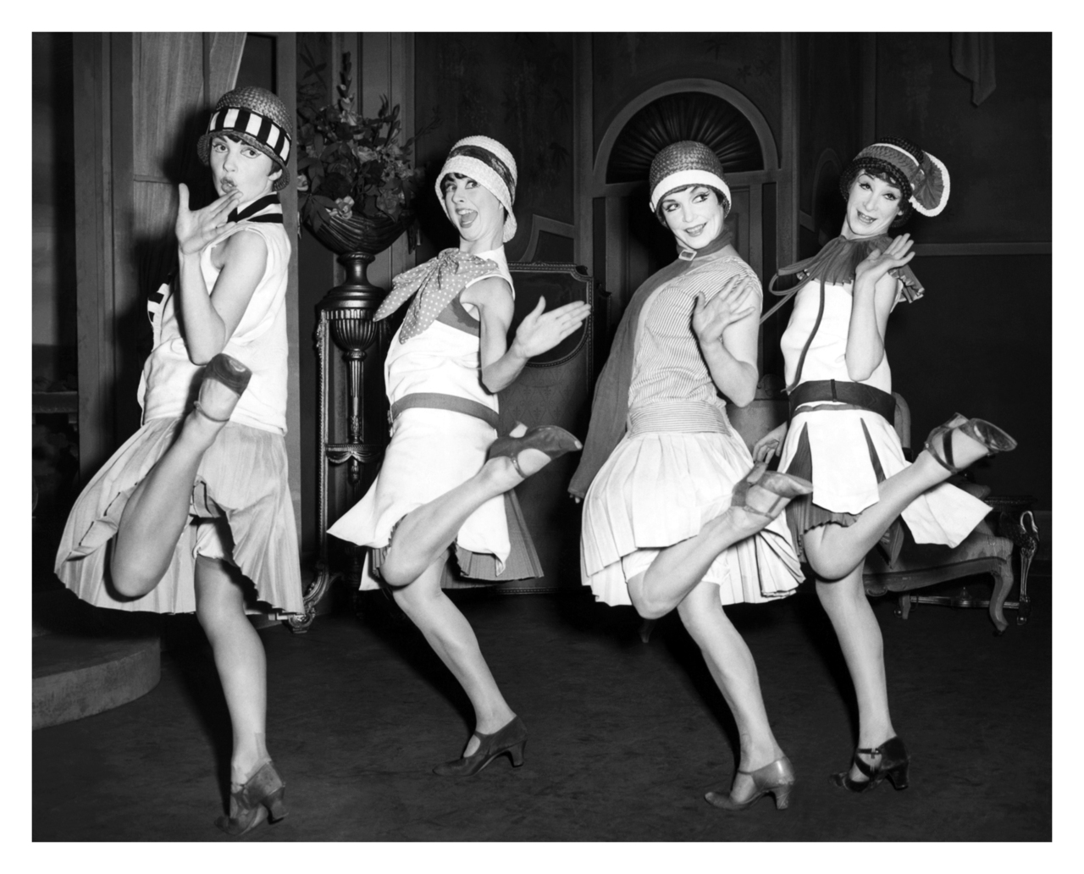
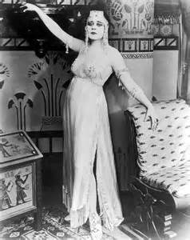

Slide 48
What we see in Gatsby, though, is an exaggerated picture of how some among the white middle and upper classes were able to live.
While Gatsby threw parties, others (e.g. African Americans in Harlem, New York) threw rent parties.

Slide 49
Identity
Concerns over immigration, late C19/early C20 (e.g. Tom and Goddard/Stoddard)
But modern America is built on immigration and colonialism:
Many of the “old money” families would have been of “high” European descent (France, Germany, and especially England)
Tom’s and Nick’s surnames are old aristocratic Scottish/English names
Many of the working class surnames would have been derived from Irish and eastern-European names

Slide 50
Progress or Decline?
“Progress”
Decline
Technology:
“Talkies”
Colour television
Recorded music
Cars
Electricity in homes (e.g. telephones)
Technology = speed/excitement
America a rich country
Prohibition/temperance
Racism still rife (KKK on the rise)
Poverty gap between wealthy whites and poor (often) non-whites
WWI left many (especially writers and artists) sceptical about morality/progress
Widespread notion of modernity as corrupting force

Slide 51
What nicknames are given to the twenties?
What do these names suggest?
Why are the twenties seen in this way?
War; plenty; transgression; change; gender
What were some of the gender/class/race/ethnicity issues at this time?

Slide 52
What nicknames are given to the twenties?
What do these names suggest?
Why are the twenties seen in this way?
War; plenty; transgression; change; gender
What were some of the class/race/ethnicity issues at this time?
What were some of the issues affecting whether the period was seen as one of progress or decline?

Slide 53
Speed plan, with references
What do you think about the view that there are no women in The Great Gatsby with whom the reader can sympathise?
How far do you agree with Nick’s view that Gatsby is “worth the whole damn bunch put together”?
“Illusory as it is, Gatsby’s dream gives meaning and value to human experience”. How do you respond to this view?

Slide 54
Another reason readers may agree with Nick’s statement is that, unlike Tom, Gatsby is an almost archetypal self-made man: he has created his wealth, whereas Tom and other “old money” men have inherited theirs. In this way, Gatsby embodies the ideals of the “American Dream” (that anything is possible in a land of supposed opportunity). [alternative interpretation – AO3] At the same time, the fact that Gatsby is “new money” is a reason that Tom sees him as worthless: against a backdrop of concerns over immigration (especially from eastern Europe) and class divisions between “new” and “old” money, Gatsby is, for Tom, “Mr. Nobody from nowhere.”

Slide 55
Agree
Disagree
Nick’s enchantment and fascination with Gatsby
Gatsby’s being worth more than the rest of the characters because he has a passion, something to aspire to
Gatsby’s dream gives Nick the inspiration to write (and of course the same can be said for Fitzgerald)
Gatsby’s life is given a purpose because of his dream
the dream links Gatsby and Nick with the Dutch sailors and the whole of American history
the dream preserves the sense of human wonder, human potential, free from limits
Gatsby is mourned by Nick and the reader whereas the other characters, the realists, perhaps, are shallow and dull, etc.
Some will disagree and focus on
Gatsby’s deluding himself
the dream being death-centred and hollow
the dream being based on corruption and crime
Gatsby’s having a basic disregard for the feelings and dreams of others
the dream being equated with wealth and getting rich
Gatsby’s house becoming no more than a tourist attraction, etc.
Relevant references might be made to the American Dream.

Slide 56
How does Fitzgerald tell the story…?
Always write about voice (Nick as narrator)
Always use Fitzgerald’s name – remind the examiner that you are aware that narrators and authors are not identical

Slide 57
221 words
Fitzgerald further develops Nick as a complicated character and narrator. As Nick reflects on his time in New York, he remarks that he “began to like” the city for “the satisfaction that the constant flicker of men and women and machines gives the restless eye.” Nick’s implied restlessness suggests that he is not satisfied, or that he is looking for something unspecified that he has yet to find, while his mention of “the constant flicker of … machines” suggests his attraction to New York’s speed, newness, and modernity. Interestingly, Fitzgerald constructs Nick as being particularly attracted to New York at “night” – which he describes as “the enchanted Metropolitan twilight” – and “dusk” – which he calls “the most poignant moments of night and life.” Twilight and dusk are both points of change or transition; that twilight is “enchanted” suggests that Nick finds something magical in New York at this time of night, but suggests, too, that whatever he sees might be illusory or artificial. Despite stating that he “began to like” New York, in the same paragraph Nick tells us that it is at these times that he felt “a haunting loneliness,” a phrase which suggests he is intensely aware, or even pursued by, his own sense of isolation. In these ways, Fitzgerald presents his narrator, Nick, as a complex yet contradictory character.

Slide 58
Fitzgerald further develops Nick as a complicated character and narrator [focus on building blocks]. As Nick reflects on his time in New York, he remarks that he “began to like” the city for “the satisfaction that the constant flicker of men and women and machines gives the restless eye.” [quotations] Nick’s implied restlessness suggests that he is not satisfied, or that he is looking for something unspecified that he has yet to find, while his mention of “the constant flicker of … machines” suggests his attraction to New York’s speed, newness, and modernity [analysis closely linked to language/meaning – AO2]. Interestingly, Fitzgerald constructs Nick as being particularly attracted to New York at “night” – which he describes as “the enchanted Metropolitan twilight” – and “dusk” – which he calls “the most poignant moments of night and life.” Twilight and dusk are both points of change or transition; that twilight is “enchanted” suggests that Nick finds something magical in New York at this time of night, but suggests, too, that whatever he sees might be illusory or artificial. Despite stating that he “began to like” New York, in the same paragraph Nick tells us that it is at these times that he felt “a haunting loneliness,” a phrase which suggests he is intensely aware, or even pursued by, his own sense of isolation [several instances of quotation/analysis]. In these ways, Fitzgerald presents his narrator, Nick, as a complex yet contradictory character, whose preference for night suggests his secretive nature [analysis of “night”].

Slide 59
Pages 57-59
Focus on Nick’s love interests and his final line:
What can we say about the way Fitzgerald presents Nick in these pages?

