Slide 1
Today’s lesson:
Do I feel more confident about planning and structuring exam responses for the Language Change question?
Starter:
What did you find challenging about the h/w tasks? Make a list, then discuss with a partner.

Slide 2
LANGUAGE CHANGE: PLANNING & STRUCTURING RESPONSES
Pitfalls in the Language Change responses
Responses must be “data-led”; this is AQA “code” for “quote lots; analyse lots.”
However: tendency for responses to be “historical sweeps,” inspired by the data, but not led by/rooted in them.
In the H/Ws I’ve seen, responses show good knowledge of linguistic methods/features, and reasonable ability at identifying these features
However, in general, stronger links to texts and more developed/critical responses are needed.
Class Targets
Try to link identified features, clearly, to:
GAP;
possible effects (on intended readers);
reasons for use/inclusion of features;
possible explanations for differences in language use between texts.
But this is not all…

Slide 3
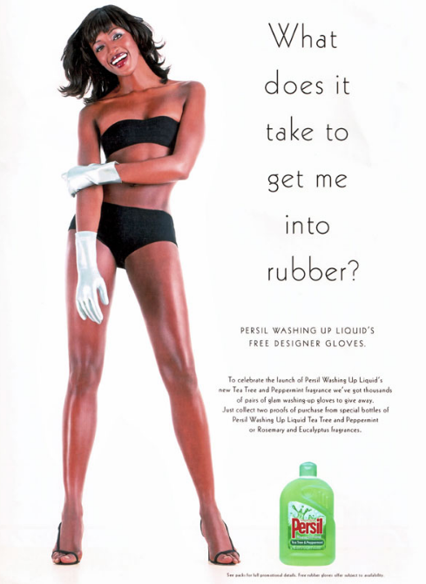
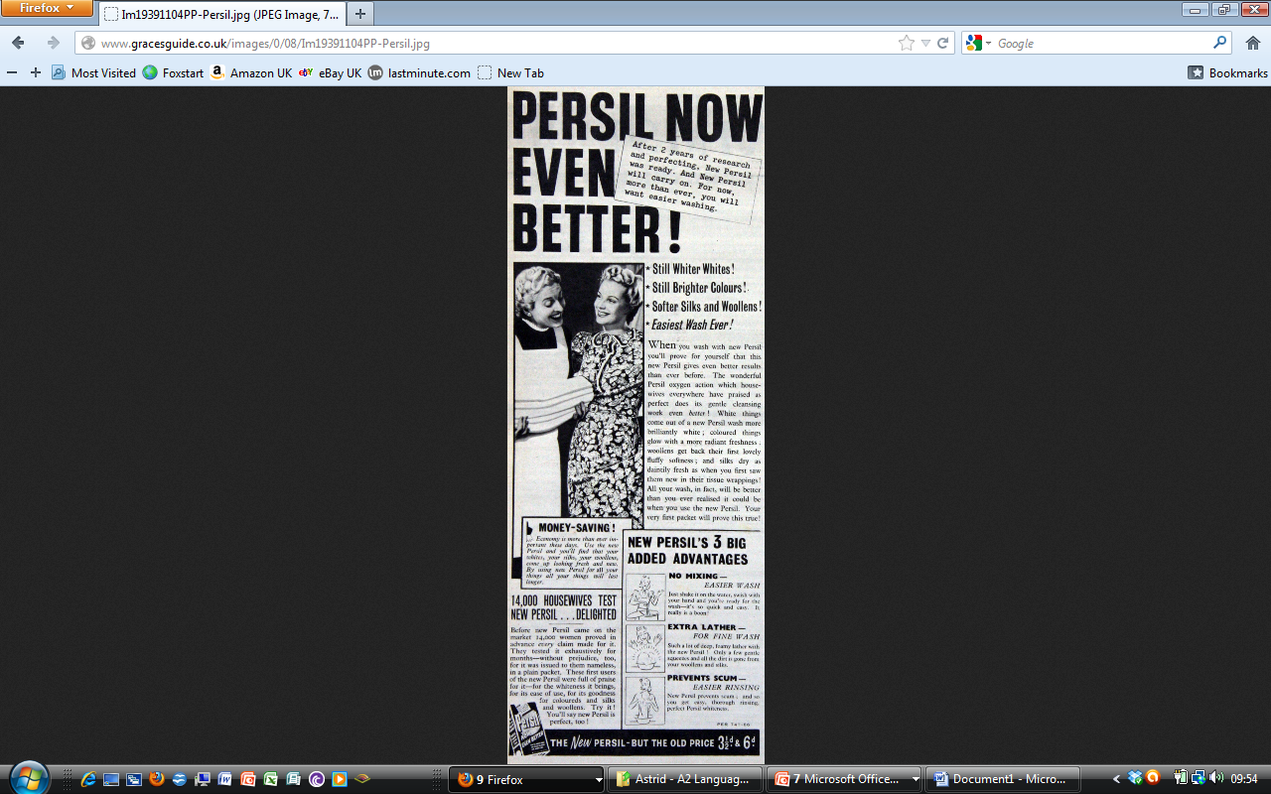
LANGUAGE CHANGE: PLANNING & STRUCTURING RESPONSES
When tackling comparative questions:
Focus is on language change, therefore focus is on differences
However, similarities/overlaps might exist, within which we can identify differences. E.g:

Slide 4
LANGUAGE CHANGE: PLANNING & STRUCTURING RESPONSES
A
Similarities:
- Stereotypical representation of women in A & B (explain/specify)
- Association of women with domesticity/domestic chores in A & B
Differences:
Two contrasting stereotypes ironically invoked in A: women do the washing up vs. supermodels don’t do domestic chores; also “extra-textual” knowledge – Naomi Campbell’s reputation for being a prima donna
B: class aspect (the “happy” maid/servant), absent in A
A: non-white body as sexy/object of desire (but still racist stereotype? Black = exotic?)
B
GRAPHOLOGY
All points worth raising, but emphasis is on language change; so link these comments to language methods/frameworks. This is all to do with...

Slide 5
LANGUAGE CHANGE: PLANNING & STRUCTURING RESPONSES
Crucially, differences like these – and, of course, more focussed linguistic analysis – must be linked to contextual reasons for changes (AO3)

Slide 6
So, for every point you raise, ask NEAL:
Name it
Evidence it (quotes)
Analyse it (reasons for inclusion; effects on readers)
Link (to reasons for differences/issues of Language Change)

Slide 7
 | A | B | A | B | A | B
Name | Graphological features; gender stereotypes | Graphological features; gender stereotypes
Evide-nce | Black supermodel (Naomi Campbell) (black is racially “marked”) | 2 women; class aspect – “happy” servant
Analy-ze | 2 gender stereotypes: sexy supermodels don’t wash up/women do domestic chores; racial overtones – black = exotic? Link to “exotic” flavours (“Tea Tree & Eucalytpus”) | Gender stereotype of women doing domestic chores; class aspect (links product to target audience); makes chores easier/more enjoyable; sex/sexuality not part of GAP
Link | Would black body have been used like this in 1930s? | Gender linked to class; washing powder/liquid not associated with middle/upper classes now
EACH COLOUR-BLOCK REPRESENTS A DIFFERENT FEATURE UNDER INVESTIGATION

Slide 8
 | A | B
Name
Evide-nce
Analyze & Link

Slide 9
Marked/unmarked
Marked/unmarked words can be words with/without modifying affixes (e.g. “dog” (unmarked) vs “dogs” (marked by plural “s”)
Can also refer to what are considered neutral/normative terms, & therefore reflect cultural values/attitudes (e.g., “man” vs “black/gay man”; “nurse” vs “male nurse”)

Slide 10
How much space/time to each part of NEAL?
N
E
A + L

Slide 11
Both texts A and B contain significant graphological features: they both draw on gender stereotypes.
N
Text A depicts the black supermodel
Naomi Campbell, while B depicts two white women – a housewife and her smiling, happy maid.
E
Text A conflates two gender stereotypes, in order to create a sense of irony. The first is the notion that “a woman’s place is in the home” (specifically the kitchen), and this stereotype is reinforced by drawing the reader’s attention to the “glam rubber gloves,” a visual symbol for washing up. The second is stereotype is that celebrities, and supermodels in particular, do not do their own washing up. This stereotype is reinforced by the reader’s extra-textual knowledge: the text assumes that we are familiar with Naomi Campbell and her reputation as a prima donna. There are also significant racial overtones to the image of a semi-naked Campbell. A non-white body would probably not have been used as a sex symbol in a mainstream advert, as Campbell’s is here, in the 1930s. This might be a sign of how attitudes towards race have changed between the early twentieth and twenty-first centuries. There is also the possibility, however, that the use of a black sex symbol in 2000 is meant to be “exotic,” which might link to the emphasis on new, exotic, and exciting flavours of Persil (such as Tea Tree and Eucalyptus).
A
&
L

Slide 12
 | A | B
Name | Graphological features; gender stereotypes | Graphological features; gender stereotypes
Evide-nce | Black supermodel (Naomi Campbell) (black is racially “marked”) | 2 women; class aspect – “happy” servant
Analy-ze | 2 gender stereotypes: sexy supermodels don’t wash up/women do domestic chores; racial overtones – black = exotic? Link to “exotic” flavours (“Tea Tree & Eucalytpus”) | Gender stereotype of women doing domestic chores; class aspect (links product to target audience); makes chores easier/more enjoyable; sex/sexuality not part of GAP
Link | Would black body have been used like this in 1930s? | Gender linked to class; washing powder/liquid not associated with middle/upper classes now
Model covers these boxes
Look at the model, then turn it over.
Write your own version (in words that make sense to/sound like you), then extend & develop the response to cover the remaining boxes from this part of the grid.
Connective words/phrases of comparison:
By contrast, ...
Text B, on the other hand, ...
Whereas...
While Text A ______, Text B ____
Useful terms/methods:
Semantic fields
Lexical/semantic ambiguity
Semantic shift
Pejoration/amelioration
Broadening/narrowing (or specialization)

Slide 13
Lessons 2-3
Finish task from end of last lesson
Develop grid for at least four more features – at least one must be to do with grammar/individual word choice
Write up response using grid as essay plan
H/W
Annotate texts and complete new comparative grid for them. At least 5 features, to be considered in detail.
Essential for next lesson – timed essay response, using grids as plans.

