Slide 1
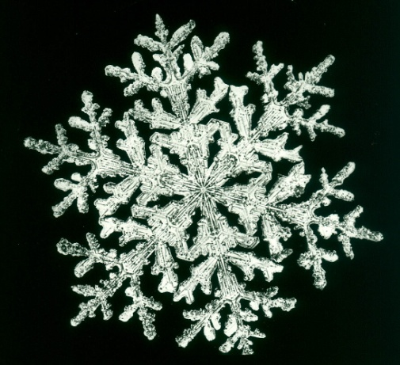
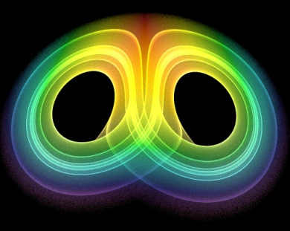
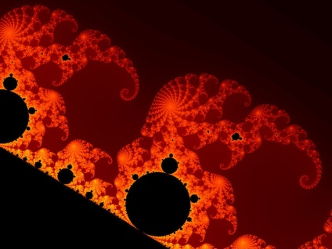
Quotations

Slide 2
Arcadia: Act 1, scene 2
Symbolism
Opening stage direction
Review significance of the study (“heterotopic space”)
Noakes’s book
Stoppard’s stagecraft
Trinity College (Cambridge)
The apple

Slide 3
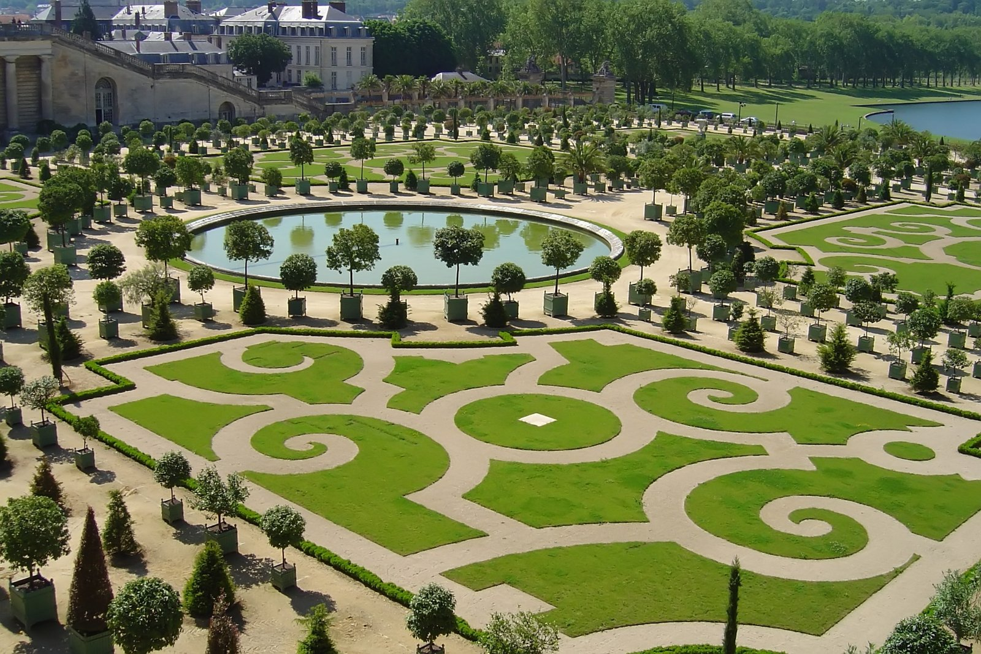

Slide 5
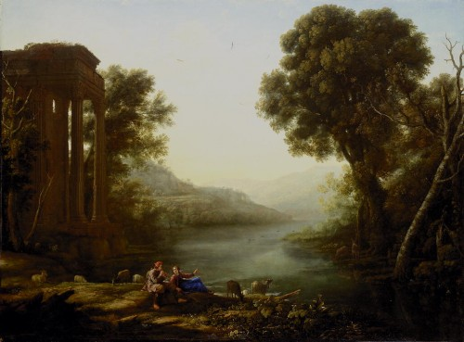

Slide 6
“The sublime geometry”
Capability Brown (C18): the landscaper as poet: "Here I put a comma, there, when it's necessary to cut the view, I put a parenthesis; there I end it with a period and start on another theme."

Slide 8
Capability Brown

Slide 9
Hannah (& Bernard)
Art versus science versus philosophy
Bernard: Well, by comparing sentence structures…
Hannah’s mindset/preferences:
“His pupil was the Croom daughter…”
“He’s doing grouse”; “computer grouse”
“… the nervous breakdown of the Romantic imagination…”
“You can stop being silly now, Bernard.”
“The whole Romantic sham…”; “the decline from…”

Slide 10
Arcadia: Act 1, scene 3: what is Thomasina’s world-view, and how does it relate to the pastoral?
Transition from 1.2 – 1.3
Apple
Thomasina: She is vexed with Papa…

Slide 11
Act 1, scene 4
At the opening of 1.4, Hannah is reading the marginalia of Septimus’s maths primer (the textbook Thomasina works from).
Who does Thomasina echo in her note?
Why does this bother Valentine?

Slide 12
Iterated algorithms

Slide 13
Place three dots on a page labeled A, B and C (leave a reasonable amount of space between each one).
A
B
C

Slide 14
Now starting at any point on the page (called "the seed"), do the following process:
Roll a die
If it comes up 1 or 2, move halfway from the seed toward dot A and make a new dot, if it comes up 3 or 4, move halfway toward dot B, or if it comes up 5 or 6, move halfway toward dot C.
Repeat this process starting at your new dot!
You obtain a new new dot. Now repeat again, and again, and again . . .

Slide 16
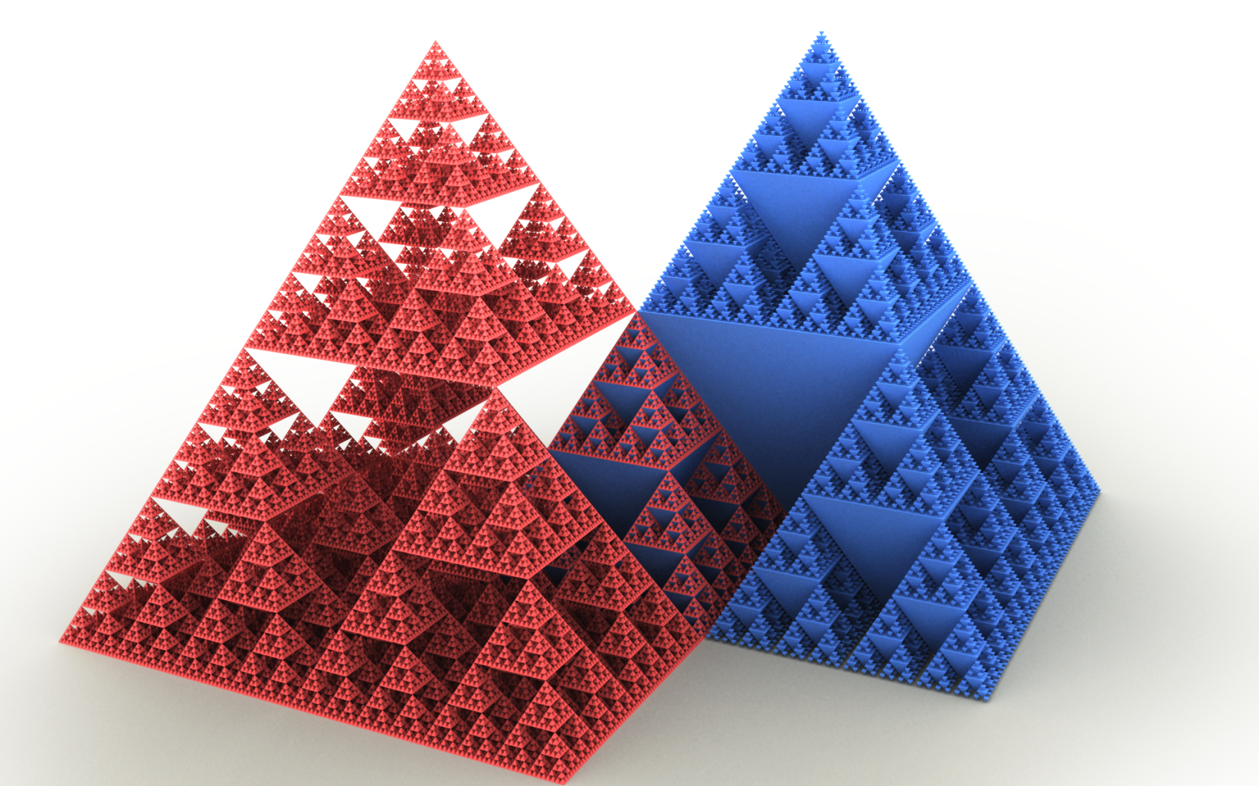
Sierpinski triangle

Slide 17
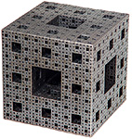
Menger Sponge

Slide 18
Scene 7
Structure?
Of timelines
“Doubled by time”: repetition with variation
The dance

Slide 19
Mandelbrot Set (Coverley Set)
Entropy (Second Law of Thermodynamics):
https://www.youtube.com/watch?v=CgppGozbFd4
Mandelbrot:
https://www.youtube.com/watch?v=MAzYWM7Yf4U
Fractals (mandelbrot in nature? God’s equations?):
https://www.youtube.com/watch?v=FCapNpKHJ_M&safe=active
Butterly effect
https://www.youtube.com/watch?v=R6NnCOs20GQ

