Slide 1
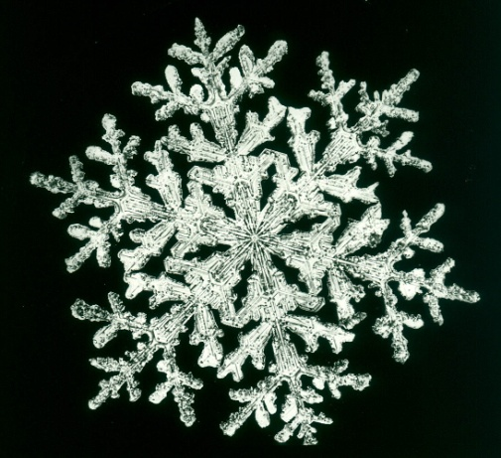
Quotations

Slide 2
Why are jammy rice pudding and foretelling the future incompatible? (Pages 8-9)
C20 Problems:
With the emergence of quantum physics in the early C20, the Uncertainty Principle is born: one cannot, with absolute certainty, know both the velocity and position of a moving body.
With the emergence of quantum mechanics, the observer effect (or the problem of Schrodinger’s Cat) is developed: the act of observation affects the outcomes.
Finally (a C19 objection): Newton’s laws of motion suppose symmetry and therefore reversibility; entropy suggests the opposite – that time/motion only moves in one direction (Eddington’s Time’s Arrow).

Slide 3
Thomasina’s comment on page 9 echoes the Marquis de Laplace (C18-19 exponent of Newton):
We may regard the present state of the universe as the effect of its past and the cause of its future [Newtonian cause & effect]. An intellect which at any given moment knew all of the forces that animate nature and the mutual positions of the beings that compose it, if this intellect were vast enough to submit the data to analysis, could condense into a single formula the movement of the greatest bodies of the universe and that of the lightest atom; for such an intellect nothing could be uncertain and the future just like the past would be present before its eyes. (1812)
In the exam, if you want to make this point, you need only write something along the lines of: Tomasina echoes the Marquis de Laplace – a leading developer of Newtonian mechanics in the eighteenth and early nineteenth centuries – when she speculates in scene 1 that ...
So, Thomasina’s world is a Newtonian and Euclidian one (“do you think God is a Newtonian?”). But it is one that will last for only a century or so more. Thomasina herself is on the brink of re-writing, re-formulating, or re-interpreting that world... but she doesn’t seem to know it yet. Perhaps she doesn’t have the language to know it?

Slide 4
More on this tomorrow. Don’t forget: Newton and fractals.

Slide 5
What is the picturesque?

Slide 6
The Picturesque (adapted from J.A. Cuddon) [make notes in own time]
During the C18, a “cult of the picturesque” emerged.
Influence of landscapers important: “Capability” Brown (p.113, “’Culpability’ Noakes”), Humphry Repton (p.15 – stage direction; Noakes’s Repton book in reverse [what movement of time does this suggest?]), William Kent.
Influence of earlier painters (C17): Poussin, Lorrain, Salvator Rosa (p. 16: Thomasina, “It is a Salvator”).
These visual influences affected writers , who now experienced “natural” order in a new, self-conscious way (so, one start-point for the shift from Shepherds to scenery?).
The more “natural” the scenery, the better; the picturesque is therefore related to the concept of the sublime, and to Romanticism.
Ironically, with the rise of the picturesque, a fashion emerged for sculpting gardens to look “more” picturesque (or natural).

Slide 7
Romanticism & Picturesque
Pages 11-12: Mocking Romanticism?
P. 15 (stage direction) & Brice (“It is rape, sir!”)
P. 16 – end of scene: significance, seriousness and conceptions of the pastoral?
Blake: scientific rationalism & creativity
Hannah, pp. 36, 38-39: Art vs science; attitudes towards landscape and “nature”; attitudes towards Romanticism

Slide 8
How do you respond to the view that Stoppard’s Arcadia is an anti-pastoral text? (Section A)
AOs 1&4: What will you do in the first paragraph of your response?
Brainstorm/bullet points: How will yesterday’s lesson inform your response ? (And which AOs will this access?)
Think/group/share: 2-3 “big” ideas (ways in which Arcadia is/isn’t anti-pastoral)

Slide 9
Planning the response (groups)

Slide 10
Newtonian and Fractal Worlds
In groups, share any research/information you have, regarding Newtonian mechanics and fractal geometry/chaos theory.
Do you think that traditional Newtonian mechanics and fractal geometry “cancel” one another out?

Slide 11
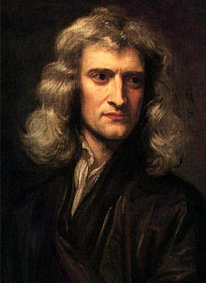
What two contrasting views of science – and what science does – are being proposed in 1 & 3?
1) “The job of science is to discover how the world really works.” Agree/disagree?
2) Thomasina: “Is God a Newtonian?” (sc. 1)
What does she mean by this? What is she “really” asking?
3) Richard Rorty
“[T]he fact that the Newton’s vocabulary lets us predict the world more easily than Aristotle’s does not mean that the world speaks Newtonian.
The world does not speak. Only we do. The world can, once we have programmed ourselves with a language,** cause us to hold beliefs. But it cannot propose a language for us to speak.”
** By “programmed” Rorty means something like: “once we have absorbed ideas to the point where they seem natural/self evident/obvious (e.g., ‘what goes up must come down’).”

Slide 12
Two views of science
Think back to Blake’s attitude towards Enlightenment/scientific rationalism.
Now look at your table from the beginning of the lesson. Has your response to our question changed or developed in any way?
1) Science as discovery
Science gradually – through experimental and theoretical trial and error – discovers how the world just is, or really is; it gives us the world’s “natural laws” (e.g., the laws according to which ice/water change states).
2) Science as invention
Science offers us gradually “better” (more accurate/precise/consistent; simpler; more complex/nuanced) ways of viewing or interpreting the world.

Slide 13
Section A, Arcadia:
What potential meanings can you find in the choice of title for this play?
To what extent do you think that, in pastoral literature, the countryside represents a place of refuge?
OR
To what extent does your reading of pastoral literature support the view that country life is wholesome and good but life in town is morally corrupt?

