Slide 1
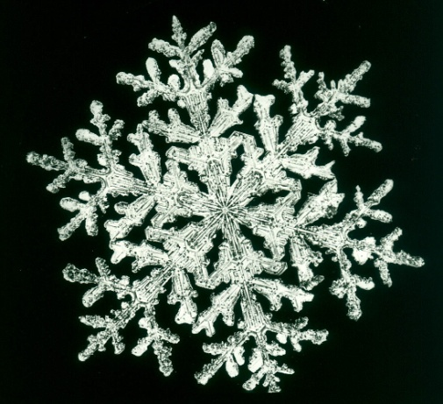
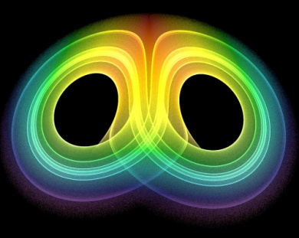
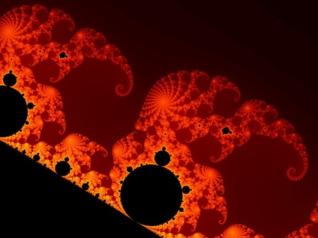
Quotations - Blake

Slide 2
Scene 1
Without looking at your texts:
In which year is scene 1 set?
How many of the characters from scene 1 can you remember?
Make a character tree/list for scene 1

Slide 3
What happens in scene 1? Write a brief summary.
P. 1 – opening stage direction
Importance of the setting – location and year
What is a theodolite?
What is the significance of the theodolite, the other books, and the study setting?

Slide 4
The Study
A space – or site – in which different worldviews, systems of knowledge (epistemologies), theories of reality (ontologies) converge, are reported on, are affirmed and critiqued:
Newtonian science
Algebra
Romanticism
Scholarly ambitions/politics
the emerging science/maths of chaos and fractal
geometry

Slide 5
Pages 6-7
Free-will/determinism: what’s the difference, and do they cancel one another out?
God a Newtonian?: What does this mean? What do you think?
Newtonian mechanics goes some way to explaining the way world just is? (Therefore, God is a Newtonian.)
Richard Rorty: “The world does not speak. Only we do.” The fact that Newton’s theories were more workable than earlier theories “does not mean that the world speaks Newtonian.”

Slide 6
Fermat’s Last Theorem
Extension of Pythagoras’ Theorem; “expository lumps”
Pythagoras, Galileo, Newton: The language in which the universe is “written” is the language of mathematics
Page 7: Overlaps with Marquis de Laplace (C18-19 exponent of Newton):
We may regard the present state of the universe as the effect of its past and the cause of its future [Newtonian cause & effect]. An intellect which at any given moment knew all of the forces that animate nature and the mutual positions of the beings that compose it, if this intellect were vast enough to submit the data to analysis, could condense into a single formula the movement of the greatest bodies of the universe and that of the lightest atom; for such an intellect nothing could be uncertain and the future just like the past would be present before its eyes. (1814)
Overlaps with Blake? An alternative take to Blake’s, re. the scientific imagination?

Slide 7
For the exam....
Tomasina echoes the Marquis de Laplace – a leading developer of Newtonian mechanics in the eighteenth and early nineteenth centuries – when she speculates in scene 1 that ...

Slide 8
Is the use of scientific/mathematic ontologies typically/atypically pastoral… or anti-pastoral?

Slide 9
The Picturesque (adapted from J.A. Cuddon)
During the C18, a “cult of the picturesque” emerged.
Influence of landscapers important: “Capability” Brown, Humphry Repton, William Kent.
Influence of earlier painters (C17): Poussin, Lorrain, Salvator Rosa.
These visual influences affected writers , who now experienced “natural” order in a new, self-conscious way.
The more “natural” the scenery, the better – picturesque therefore related to concept of the sublime, and to Romanticism.
Ironically, with the rise of the picturesque, a fashion emerged for sculpting gardens to look “more” picturesque.

Slide 10
Romanticism & Picturesque
Pages 11-12: Mocking Romanticism?
Pages 15 (stage direction), 18 – end of scene: mocking the notion of the pastoral?
34-39: Art vs science; attitudes towards landscpare and “nature”; attitudes towards Romanticism

Slide 11
Arcadia and the Pastoral
Is Arcadia adequately described as an anti-pastoral play?
Perhaps “post-pastoral” might be better? Why?

