Slide 1
Lesson 1

Slide 2
GCSE Practice: English Language
Summer exam: Full English Language paper

Slide 3
Q. 1) What must you do to get the best possible mark?

Slide 4
What the local people believe
That the beast escaped from the local zoo
That the beast is a big cat, probably a puma
Paw prints; scratch marks; appearance/movements; compared recordings of puma calls to what they hear at night
Can’t be a dog: doesn’t look like one; doesn’t kill like a dog

Slide 5
Own memories/experiences
Movement/appearance of the “beast”
Supernatural encounter?
Excited about the story when she was young
Disappointed when some evidence proved to be a trick

Slide 6
She is convinced that the locals are right/onto something – the “beast” is a puma/big cat.
If government don’t help control the animal, the animal or people could get hurt or shot; if the government don’t help, and beast carries on attacking the livestock, farmers could lose their business

Slide 7
The purpose of the first paragraph of a news report is to answer: Who, what, when, where, why

Slide 8
English Language: Q.2
Pick two words from the following extract. Write each one as a sub-heading, and underneath explain why the words are effective and/or interesting.

Slide 9
Alliteration: Repetition of sounds next/close to one another
Metaphor: When one thing is described/presented as another
Simile: When one thing is likened to/compared to another
Word choice: verbs, adjectives, nouns, adverbs

Slide 10
Question 2
150 words written about each paragraph.
25-30 words written on each key word.

Slide 12
“Supernatural manifestation”
“Supernatural” – effective adjective that makes the “beast” seem to be other wordly. “Manifestation” – effective noun that makes the “beast” seem almost ghostly, or like an appearance.

Slide 13
Everest: Situation/Problem
Conditions getting worse/more dangerous
Mick Burke is lost (still at the peak/top of the mountain)
Waiting ten minutes for Mick – will they have to leave him behind?

Slide 14
Everest: Sequence of Events
They wait ten minutes before leaving without Mick
Leave the stove behind
Blizzard starts
Too far down the south mountain pass
Two avalanches
Pertemba Sherpa stops him from falling, with the rope around his waist
They reach base camp and Martin is there

Slide 15
“Powder-snow avalanche”
“powder-snow” tells us that the snow is light and new, powdery
But “avalanche” tells us also how powerful it is – potentially deadly.

Slide 16
English Language: Q. 3 Practice
Question 3 asks you to show understanding through summary and explanation.
You can use short quotations, but, for the best possible marks, you should use your own words as much as possible.

Slide 17
What reasons are given for banning boxing?
There is no rational argument for permitting boxing. Allowing two men (or, increasingly, women) to stand toe to toe punching the living daylights out of each other for the enjoyment of others is insane and barbaric. Similarly, with hunting: it is monstrous that several hundred people and a pack of hounds should get an afternoon's enjoyment out of pursuing a terrified fox for several hours before tearing the exhausted animal apart. In the case of boxing, the British Medical Association's arguments cannot be resisted. Boxers' brains are reduced to mush by the constant pounding: even if they manage to escape the sort of catastrophic blood clot on the brain that overwhelmed Paul Ingle as he defended his world featherweight title on Saturday, they may face a lifetime of slurred speech and slowed movement.
Most boxers don't even get rich out of it: the game is littered with great champions, notably Joe Louis, who ended up penniless and propping up bars, grizzled relics of great careers. Promoters and TV companies cream off most of the money, and every champion has his retinue of hangers-on looking to cash in on his courage. As for the journeymen, many are being paid to act as punchbags for young hopefuls who want a 20-0 record to get a crack at a title.

Slide 18
To allow such a brutal and dangerous sport is madness (“insane”)
It is compared to hunting for being violent and “barbaric”
Medical risks:
Brain damage
Blood clots (example of Paul Ingle)
Poorly paid (most “don’t even get rich”)
People who don’t make it (“journeymen”) end up being paid to be beaten up (they are “punchbags”) by younger fighters (“young hopefuls”)

Slide 19
Q.3
Answer the questions in the order set.
(a) Notes
What are the reasons for …?
Write your answer using short notes.
You do not need to use your own words.
Up to 15 marks are available for the content of your answer.

Slide 20
You do not need to use your own words
You don’t have to use your own words, but if you only quote you will not get full marks.
Short quotations and paraphrase is best.
Paraphrase: expressing an idea in different words.

Slide 21
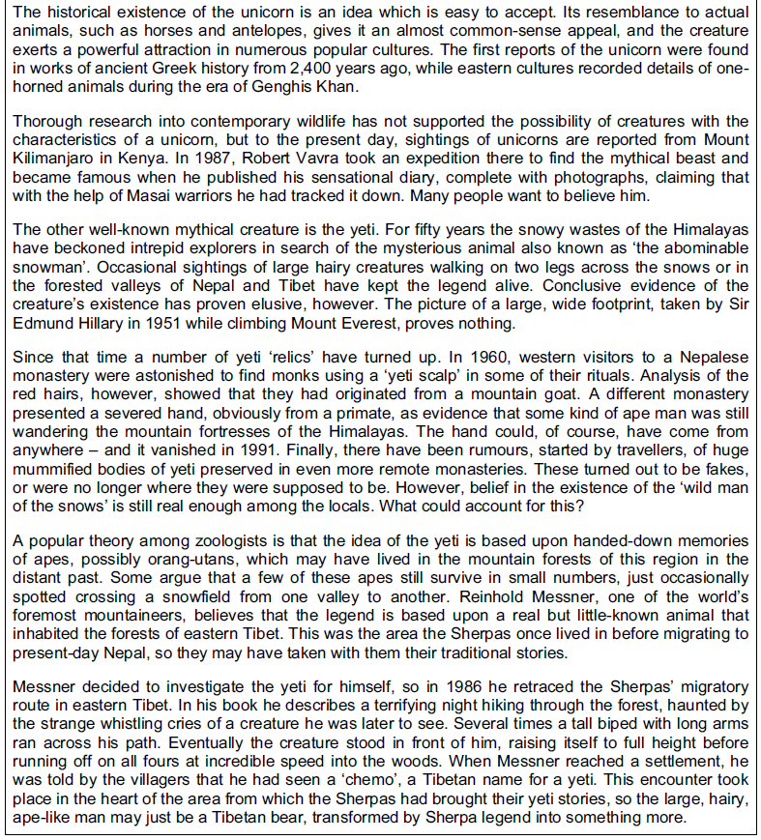
What are the reasons for not believing in the existence of unicorns and yetis, according to
Passage B?
Highlight the points before you summarise

Slide 22
May have been a “tall biped” – so it could have been anything large, two-legged animal.

Slide 24
Different Versions of Q.3
Check the list of possible answers to 3(a)
Add as many as you need to take you to fifteen.

Slide 26
OK: “Looks like a bear…”
Better: “May have been confused with a type of Tibetan bear…”

Slide 27
Different Versions of Q.3
(a) Notes
What are the reasons for not believing in the existence of unicorns and yetis, according to Passage B?
- Write your answer using short notes.
- You do not need to use your own words.
- Up to 15 marks are available for the content of your answer.
(b) Summary
Now use your notes to write a summary of what Passage B tells you about the reasons for not believing in the existence of unicorns and yetis.
- You must use continuous writing (not note form) and use your own words as far as possible.
- Your summary should include all 15 of your points in Question 3(a) and must be 200 to 250 words.
- Up to 5 marks are available for the quality of your writing.

Slide 29
This is NOT an essay.
You should not write an introduction or conclusion.
Use your own words as far as possible.
Be brief, precise, and relevant.

Slide 30
Swap and Assess

Slide 32
Exam Practice: Qs 1 & 2
Start reading the extract “Saved” (labelled “Source 3”)

Slide 33
Qs1 & 2
1) Write the words to an interview with Parrado and Canessa. The following three questions are asked:
Why were you walking through the South American mountains, and what were you hoping to find?
What happened once you left the wrecked plane?
How did you feel when you discovered the valley?
Write about 250 – 300 words. Address each of the three questions.
2) Re-read from “The view which met his eyes…” until the end.
Pick 8 words or phrases and explain how the writer uses them to create effects.

Slide 35
Exam Practice: Q. 3
Read

Slide 36
Class Mock: Pt. I
Read “Rafting on the Grand Canyon,” by Elizabeth Hyde.
You are Elizabeth Hyde’s husband, writing a group email to friends to inform them about your holiday. Tell your friends about:
Where you were going, who else was there, and what you were going for
What you did and what you saw
What happened to your wife, and how you and she felt about it afterwards
Address all three bullet points. Write about 1 ½ sides, allowing for the size of your handwriting. 20 marks are available for the content of your answer. (40 minutes)

Slide 37
2) Pick 8 words and/or phrases from across the text, and explain how the writer uses them to create effects. Set the quotations out as sub-headings, and write approximately 30-50 words about each quotation. 10 marks are available for the content of your answer. 15 minutes.

Slide 38
IGCSE, Q.1: Demonstrating understanding by retelling
Question 1 always involves the taking of relevant information from a piece of writing, and putting it in your own words.
15 marks for understanding; 5 marks for quality of writing.
How long you should take reading the extract?
How long should you take writing your response?

Slide 39
10 minutes reading (12 with extra time)
40 minutes writing (50 with extra time)

Slide 40
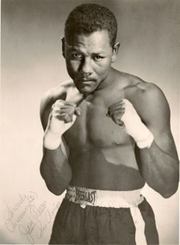
Read the article “Portrait of a Young Prize Fighter,” about Puerto Rican boxer José Torres.
Write the text of an interview with Cus D’Amato, the trainer of José Torres. The following three questions are asked:
Tell us about José’s training routines, and some of the famous boxers he has trained with.
What kind of a boxer is José Torres?
What are José’s hopes for the future?
Base your interview on what you have read, but use your own words as much as possible.
Write about 350 words.

Slide 41
Annotate/highlight, using numbers or colours, for each question.
You will need to write approximately ___ words in response for each question, but there doesn’t have to be an exact balance.

Slide 42
IGCSE: Question 3 - summarizing
Summarize p.57 only of “Portrait of a Young Prize Fighter.”
Use your own words.
How many points can you make in 5 minutes?

Slide 43
Q.3
Question 3 asks you to summarize.
There are 15 marks available for 3(a) (the listing exercise); there will usually be 1 mark available per point, and you will usually be asked to make 15 points.

Slide 44
Challenges of Q.3?
Using own words to demonstrate understanding
Being brief and succinct, yet precise, clear, and specific

Slide 45
Things to avoid:
22; sad, dark eyes
Six fights
Dozen shirts
Wants to marry her
22 years old
Young, but his eyes and face show his experience as fighter
He’s had six professional fights
He owns twelve silk shirts
He hopes to marry his girlfriend soon

Slide 46
Summarize what you learn about animal life in the rainforest. (15 marks)
How many points can you make using only the first paragraph?

Slide 47
When I tried to think of all the animals I wanted to see, those old travellers’ tales kept flooding into
my thoughts, the tales of weird and dangerous creatures everywhere in the forest. But reality is not
like this. In the forests, most animals are small. The problem of moving through trees when danger
threatens has prevented any really large animals surviving for long within the forest proper, particularly
anywhere far from water. Most animals are highly camouflaged, which creates a problem of its own:
how does each recognise its mate? Moving around in daytime would make the camouflage useless, so
most animals stay motionless during the day and only move about at dusk. Then it is more difficult to be
seen, but they can be heard. That is why the forest is hushed by day but noisy with recognition signals
by night.
Reality of the wild-life not like the old stories/myths
Expectation is for animals to be large and dangerous; in fact, most animals small
Small animals survive better, as they can avoid predators
Large animals don’t survive deep in the forest, far from water
Most animals hidden (“highly camouflaged”)
Camouflage can make it hard for animals to recognize breeding partners (mates)
Most animals in rainforest are nocturnal; movement during day would make camouflage useless
Because of nocturnal activity, rainforest is quiet during the day, but noisy at night, with animals communicating with one another

Slide 48
Question 3: To time, inc. reading
45 minutes to read and do both parts of q. 3:
What do you learn about Mike Gillan’s work as a farrier (horseshoe maker and fitter)?
Make notes, using your own words as far as possible. (15 marks)
Turn your notes into a paragraph. You must try to include all points that you have made in part (a). (5 marks)
10 minutes: reading
30 minutes: writing (a)
10 minutes: writing (b)
Vocab:
“Capezio”: maker of fine ballet and dance shoes
“Patronized”: in this context, it means people who give him his business (i.e. his patrons are his customers)
Barry Fitzgerald: Hollywood actor born in Ireland; died in 1961 aged 73.

Slide 49
What do you learn about Mike Gillan’s work as a farrier (horseshoe maker and fitter)?
He makes high quality shoes (“the Capezio of horseshoe makers”)
He deals with wealthy owners/expensive/successful horses
He is very successful
No customer has ever returned a horseshoe he has made
He is popular/has many regular customers/many horses have been using his shoes for years
The work is physically tiring/demanding (you need a “strong back”)
He shoes about 175 horses
Most of the horses he deals with are hunting or racing animals (from the Long Island area)
He shoes will generally last between one and three months
He charges $10, $25, or $50 for a pair of/for every two shoes, or more if he thinks the customer will pay more
Adjustments cost between $3 and $5.
He has a shop on Split Rock Road, but will travel to the stables of horses to fit shoes
He has fitted shoes on famous/well-known/successful horses (e.g. ones own by Jock Whitney and Marshall Field)
People do not notice him working at horse shows
At shows, he works thirteen-hour days (10 AM to II PM)
He is confident in himself and his work (“swaggering little man”)
If a horse loses a shoe during a show, Gillan has to refit/fix it within seven minutes; he never fails
He is the official shoe-fitter for the Garden shows, and has been for six years
Every show, one or two horses will lose a shoe
He has been fitting horseshoes for forty-two years/since 1916
He started fitting milk-wagon horses, then moved on to military horses (cavalry) during WWI, then on to hunter and race horses
He makes a good living as a farrier
He finds horse shows dull.

Slide 50
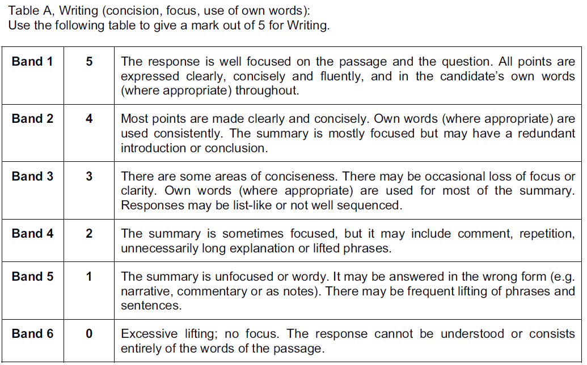

Slide 51
IGCSE Eng. Language: Question 1
Start reading the extract.

Slide 52
You are Yankees pitcher Bob Kammeyer. Address the following points, writing as Kammeyer.
Write about:
How you feel about Cliff Johnson
Why you threw the ball at Johnson
What has happened, and might still happen, as a result of your actions.
Write about 350 words. Use your own words as much as possible. Address all three bullet-points.

Slide 53
Q.2 Practice – Quotation and Analysis
Brief quotations
Analyse language in detail – comment on the effectiveness of the words/phrases (e.g., say what the author is trying to achieve and/or the likely effects on the reader)
Discuss imagery

Slide 54
No:
“The use of X is effective because it draws the reader in.”
“The use of the X is effective because it has a dramatic effect on the reader.”
Yes:
The image of a “skin of boiled milk” presents a nightmarish situation in terms of something very familiar, something that might even be an image of childhood comfort in normal circumstances. It gives the reader a vivid and disconcerting sense of the texture of Ralston’s decaying flesh. (47 words)

Slide 55
8 quotations: how/why are they effective?
LONDON. Michaelmas Term lately over, and the Lord Chancellor sitting in Lincoln’s Inn Hall. Implacable November weather. As much mud in the streets as if the waters had but newly retired from the face of the earth, and it would not be wonderful to meet a Megalosaurus, forty feet long or so, waddling like an elephantine lizard up Holborn Hill. Smoke lowering down from chimney-pots, making a soft black drizzle, with flakes of soot in it as big as full-grown snow-flakes — gone into mourning, one might imagine, for the death of the sun. Dogs, undistinguishable in mire. Horses, scarcely better; splashed to their very blinkers. Foot passengers, jostling one another’s umbrellas in a general infection of ill-temper, and losing their foot-hold at street-corners, where tens of thousands of other foot passengers have been slipping and sliding since the day broke (if the day ever broke), adding new deposits to the crust upon crust of mud, sticking at those points tenaciously to the pavement, and accumulating at compound interest. Fog everywhere. Fog up the river, where it flows among green aits and meadows; fog down the river, where it rolls defiled among the tiers of shipping and the waterside pollutions of a great (and dirty) city. Fog on the Essex marshes, fog on the Kentish heights. Fog creeping into the cabooses of collier-brigs; fog lying out on the yards, and hovering in the rigging of great ships; fog drooping on the gunwales of barges and small boats. Fog in the eyes and throats of ancient Greenwich pensioners, wheezing by the firesides of their wards; fog in the stem and bowl of the afternoon pipe of the wrathful skipper, down in his close cabin; fog cruelly pinching the toes and fingers of his shivering little ’prentice boy on deck. Chance people on the bridges peeping over the parapets into a nether sky of fog, with fog all round them, as if they were up in a balloon, and hanging in the misty clouds.

Slide 56
Quote Bank

Slide 57
Look up any unfamiliar words and write them and a brief definition in your exercise book.
20 minutes to write a response.

Slide 58
English Language: Q.2 (quotation and analysis)
10 marks
Approx. 20 minutes
To get highest marks possible:
Avoid general comments (“this draws the reader in”; “this creates a strong image in the reader’s mind”)
Comments should be specific: why this particular word/phrase?
Identify techniques: simile, metaphor, alliteration; strong word choices (nouns, verbs, adverbs, adjectives…)
Comment on imagery
Write about the overall emotional effect and/or purpose of the passage
Focus on language, but, if appropriate, comment on, e.g., syntax/punctuation in addition to language
We will read the whole passage together.
Then, focus on paragraphs 2-4:
How does the writer Laurie Lee present the landscape and his childhood reaction to it?
8 quotations; at least 2 from each paragraph.

Slide 60
Swap and mark in green.
Comments must talk about particular effects/images/intentions etc.
**Test: if you can attach the comment, without any changes, to any quote, it is not focussed enough.
Do not give credit for:
“draws the reader in”
“creates a strong image in the reader’s mind”

Slide 61
Paragraph 2
“The June grass […] was taller than I was, and I wept”: child feels small amongst nature; intimidated; lost
“It towered above me”: use of “tower” as verb – image of nature as threatening; seems huge to child, as if closing in on and over him
“each blade tattooed with tiger-skins of sunlight”: image of sunshine through leaves, but nature as dangerous/violent/sharp; leaves/nature almost like weapons
“knife-edged, dark, and a wicked green”: colour imagery representing malevolence/evil/threat; grass as violent/threatening/sharp
Insects “like monkeys”: mischievous; seem bigger and louder than they really are; threatening

Slide 62
Paragraph 3
“A tropic heat oozed up”: imagery makes village green seem like tropical jungle; verb “oozed” – image of jungle-like green as slow, thick, sticky, & oppressive in the heat
References to smells (“sharp odours”, “fumes”): overwhelming and thick; overpowering, as if hard to breath (“suffocation”)
“High overhead…tearing apart”: Image of natural world as violent, menacing, chaotic; nature as uncontrollable (“frenzied”), distressed/distressing (“screaming”); the child’s world coming apart at the seams

Slide 63
Paragraph 4
Repetition “For the first time in my life”: emphasises sense of isolation, of being lost/abandoned/confused
“a world whose behaviour I could neither predict nor fathom”: the world as unknown and unknowable; the world has hidden/unseen depths (“fathom”); the world personified as unpredictable/unreliable/untrustworthy (“whose behaviour”)
“howled”: image of child’s complete and utter distress; almost animalistic in his despair
“the sun hit me smartly on the face, like a bully”: image of sun, personified as bully through simile; all aspects of nature usually presented as comforting/beautiful are threatening/violent/malevolent; feels like a personal attack on the boy (“like a bully”)

Slide 65
English Lang., q.1: Directed Writing
Approx. 45 minutes
15 marks for understanding
5 marks for quality of writing (convincing & appropriate style/voice)
Writing based on text; use own words wherever possible
For the additional 5 marks, you must try to adopt a convincing style/voice.

Slide 66
Starlight was skittering across the waves and a few giant fruit bats were heading towards the middle of the island. Moses and Tony, my local guides, looked at me expectantly. I had to decide where to go. I resisted the desire to say: “Let’s just stay here. I can snorkel the reef and photograph the hummingbirds at my hut window.” Why go anywhere? I had travelled to the other side of the globe, to the remotest spot imaginable, and now, having arrived in darkness at a surprisingly comfortable backcountry surfer retreat, I was planning to leave at dawn.
Sets the scene/landscape
Introduces people/characters
Own thoughts/feelings
More details about what/where/
when

Slide 67
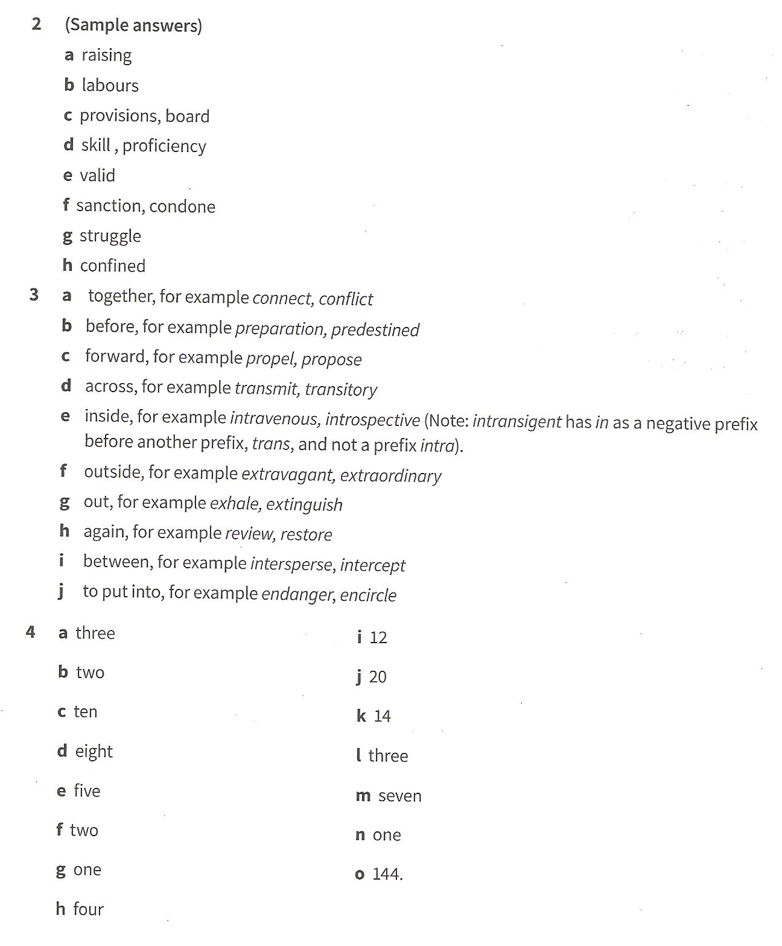

Slide 68
Imagine you have visited the sanctuary, and seen the elephants in action. Write a review for a newspaper explaining:
- what the organization is, and what its aims are;
- what you saw while you were there and what you thought about it.

Slide 70
http://www.theguardian.com/travel/2015/mar/08/papua-new-guinea-kayaking-holiday

Slide 71
English Language Exam (05/05/15: 13 lessons remaining)
The exam: more strictly marked than we thought.
Mocks: our class marked strictly, but…
Q1 (out of 20; R = 15, W = 5): Examiners are looking for particular things.
Next week, we’ll go through total marks (CW+S&L); this will give you a better picture of total marks remaining before you reach a C, B, or A.
So…

Slide 72
The strategy:
Q.1 asks you to show understanding by rewriting a passage from another POV.
You are asked to address 3 bullet-points
The bullet-points assess your ability to:
Retrieve/show understanding of information/facts
Explain information/facts
Make inferences (read between the lines; show understanding of feelings/emotions etc.)

Slide 73
This question is marked on a tally system under the following headings:
A1
A2
A3
Detail
Development
A = “answer” (so A1 = bullet-point 1)
Detail is all the names of people, places, times, dates etc. used in the original which you might need.
You should circle/underline/highlight all relevant detail as you read the passage.
Development is the extent to which you develop the voice of the speaker and their opinions with reference to the original text. I.e. you understand why the person is there/what they want/how they feel…

Slide 74
The marking is systematic, which means…
Your answers will be (relatively) formulaic.
24-30 points on the list of acceptable answers, for A1-3.
6-9 points to be covered for A1.
5/6 for A2.
3 substantial points for A3
Treating the bullet-points equally means writing approximately the same amount for each. So you will expand the detail in each bullet-point.
C = approx. 11/20
A = approx. 14/20

Slide 75
Read and highlight for each bullet (you may want to label the information for A1 and A2 especially; or you might want to colour-code)
You are Pascal Sanches, the journalist. Write a magazine article for Conservation Magazine based on your visit to the Indonesian Rainforest, with the title “Palm Oil Threat to Indonesian Rainforest.”
Comment on:
your own memories of the rainforest and your experience of seeing an orangutan;
an explanation of the threat to the rainforest and the orangutans
your feelings about the rainforest and the orangutans and your predictions for their future.

Slide 76
You are Pascal Sanches, the journalist. Write a magazine article for Conservation Magazine based on your visit to the Indonesian Rainforest, with the title “Palm Oil Threat to Indonesian Rainforest.”
your own memories of the rainforest and your experience of seeing an orangutan;
an explanation of the threat to the rainforest and the orangutans
your feelings about the rainforest and the orangutans and your predictions for their future.

Slide 77
Now look at the mark-scheme.
How many of their points did you highlight?
C = approx. 9 points + 2-3 for writing
B = approx. 10 points
A = approx. 11-12 points

Slide 78
Now look at the model answer; annotate and mark (A1 etc.)
Tomorrow: question 1 practice

Slide 80
English Language, Q.1 (12 lessons left)
Read the task and the passage.
Highlight (as yesterday)
Refer to mark scheme: how did you do?
Read C response.
Improve upon this: work on lined paper
Finish for HW: due Monday

Slide 82
English Language, Q.2 (11 lessons left)
Q.2 asks you to analyse the language from two selected passages in Text A.
You must analyse the effectiveness of brief quotes.
You must show understanding of basic meaning and of the effectiveness in/to the passage.
You must show an awareness of imagery.

Slide 83
Approach (1)
You can be formulaic (bad for some, comforting for others)
The major difference between a C and an A is coverage of the passages. This means:
Expectations of quality for C-A are similar
C answers: expectation is that you will cover 3-4 quotes, but you will comment effectively on them
A answers: as above, for 6-8 quotations
To be on track for a C, you need around 4/10; for an A, around 5-6/10

Slide 84
Approach (2)
Because the paragraphs will be relatively short, the examiners have a list of the most obvious quotes in mind (the list will usually be longer than 8 quotes)
You must show awareness of basic meaning first:
“Mouth of the crater” refers to the opening of the volcano…
Imagery: you do not have to say “this is imagery”
You should use visual language to describe effectiveness: “paints us a picture,” “helps us see,” “creates an image of”…

Slide 85
30 words minus quote
“The mouth of the crater” refers to the opening at the top of the volcano. The use of “mouth” as a metaphor creates an image of a wide, gaping opening, which might swallow the visitors.

Slide 86
Re-read the passage from last week’s handout.
Select quotations from the relevant passages.
Check mark scheme.
Only allow yourself quotes from the mark-scheme.
How many quotes do you have.
Write a response to two quotes (60-100 words).
Comment on imagery.
Compare to model answer.

Slide 88
Eng. Lang. Q.3 (10 lessons left)
Question3:
Split into (a) (15 marks) and (b) (5 marks)
Based on a second reading passage
(a) Summarise in note form
Examiners will accept own words or quotes, provided they demonstrate understanding
Do not repeat any one point
(b) Turn summary into continuous writing
To get 3 or above, you must include all of your 15 points

Slide 89
On track for a C:
8-9/15 on (a); 2-3 on (b)
On track for an A:
10-12 on (a); 3+ on (b)

Slide 90
Whole Exam
On track for a C
On track for an A
Q.1: 9-10
Q.2: 3
Q.3: 8-9
Total: 22-23
Q.1: 14
Q.2: 5-6
Q.3: 13+
Total: 32/33

Slide 91
Q.2: Quotation & Analysis
Read through the extract.
(If you think you’ve read it before, that’s because you have!)

Slide 92
Q.2: Quotation & Analysis

Slide 93
Look at the descriptions of the grass and plants in paragraphs 2 and 3:
Pick 4 words/phrases from each paragraph, and explain how the language is used effectively in context. You must write about…?

Slide 94
Why not these?

Slide 95
English Language Revision & Practice: Q.3 (8 lessons left)
Hand in homework.
No HW: lunch/after school today and tomorrow to catch up.

Slide 96
Q.3a
Read the following piece about the Datca peninsula in Turkey.
List 15 things you learn about Datca, Knidos, and the area.
Use notes.
You do not need to use your own words.
Do not substantially repeat the same point/idea
10 minutes reading/highlighting
15 minutes writing
**Number all your points**

Slide 97
The spindly, 50-mile-long Datça peninsula in Turkey’s Muğla province is a dagger of pure green at the meeting point of the Aegean and the Mediterranean, and is as unsullied as south-west Turkey gets. The ancient Greeks believed Datça to have been created personally by Zeus, so gorgeous are its rocky outcrops and aquamarine waters. The geographer Strabo apparently said: “God sent his beloved creatures to Datça for them to live longer.”
So what’s all the fuss about? It’s about craggy, pine-crested hills, endless olive groves, empty ravines, cornflower-blue coves, vast sweeping bays and deserted beaches, air scented with thyme, rosemary and sage, and sleepy villages. It’s about goats on the road and old men tinkering with their worry beads in vine-covered cafes.
Although this backwater peninsula is wedged between moneyed Bodrum to the north, and overdeveloped Marmaris to the south, bad road access and its distance from airports have left it unspoilt. Tourists do come and stay in a new clutch of upmarket hotels, and city-dwelling Turks are buying second homes here, but most visitors still only make short stop-offs on boat cruises.
Remnants of the Karians – who settled here in 5400BC – and the cultures of Lydia, Persia, and the Byzantine and Ottoman empires, stud the landscape: there are church ruins, ancient cisterns, tombstones and ruined olive oil facilities.
On the southern shore, workaday, harbour-front Datça is the main settlement. It’s not built for tourists but this is where you’ll find most of the restaurants. In the hills above town is Old Datça which, by the 1980s, was more or less abandoned, but is now having a mini renaissance. Then there is a 235-mile coastline to take in, Datça’s sleepy villages and landscapes, and its most precious jewel: the ancient Greek ruins of Knidos, a city at the confluence of the Mediterranean and the Aegean.
Knidos, the ancient ruined harbour, was a shipping stronghold from the 4th century BC. Astronomers (including Eudoxus the Mathematician), medics and architects (including the architect who designed the Beacon of Alexandria, one of the Seven Wonders of the World) congregated here. Its most famous poster girl, though, was its nude Aphrodite statue, which had a cult following – Pliny wrote that many came just to admire it. Knidos fell into ruins through earthquakes, conquests and looting – the last treasures were spirited away to the British Museum – and Aphrodite disappeared entirely more than 1,000 years ago. Notable remains are a few basilica arches, floor mosaics and the exceptional sea-facing theatre. The drive there is heavenly, following the backbone of the peninsula, passing forested hills and winding through gorges. Once there, the site has a spiritual quality; it is largely empty but for a handful who climb the silent steps of the antique theatre and pick the daisies on the hillside. In its heyday, it must have been fantastic: a marble city with terraces descending to the sea, full of temples, and home to 70,000 people. At the site there is an old-fashioned restaurant serving meze, fish and koftas.

Slide 98
29 possible points; don’t panic if your answers aren’t all on the next slide!

Slide 99
Datca peninsula is 50 miles long
Situated where the Aegean sea and the Mediterranean ocean meet
Unspoiled (“unsullied”)
Beautiful area
Ancient Greeks believed Zeus created Datça
The geographer Strabo thought to have said that “God sent his beloved creatures to Datça for them to live longer.”
Landscape inlcudes rocks, tree-topped hills, olive groves, “empty ravines, cornflower-blue coves,” large bays., “deserted beaches”
Air smells of herbs (thyme, rosemary and sage)
Traditional villages/villagers
Datca located between rich (“moneyed”) Bodrum & busy/”overdeveloped” Marmaris
Road access is poor, so it is relatively unspoiled
Tourists do come and stay, but mostly short visits as part of cruises
Remains of ancient cultures still to be seen (e.g. church ruins, ancient cisterns, tombstones and ruined olive oil facilities)
Main settlement is on the southern shore
Not built for tourists but most restaurants are here

Slide 100
This area is having a rebirth (“mini renaissance”) after being mostly abandoned
Datca has a 235-mile coastline
Main attraction (“its most precious jewel”) is ancient Greek ruins of city of Knidos
Knidos was a shipping stronghold from the 4th century BC
Many influential people (e.g. astronomers , mathematician, doctors/medics, architects) visited
Most famous for nude Aphrodite statue
Knidos ruined by earthquakes, attacks (“conquests”) and looting
Aphrodite disappeared entirely more than 1,000 years ago
Still remaining are: a few basilica arches, floor mosaics and the exceptional sea-facing theatre
Drive to Knidos is wonderful/”heavenly”; passes through incredible scenery
Knidos has a “spiritual quality”
Knidos mostly empty, except for a few climbers who pick daisies after climbing the theatre’s steps
Must have been beautiful/fantastic/amazing in its prime (“heyday”)
At the site there is an old-fashioned restaurant serving meze, fish and koftas.

Slide 101
3b: Turn list into a piece of continuous writing
C = 8-9
A = 13+
10/15 mins
For 3+ you must include all of your points
3+ involves well structured, clear, concise, accurate
No need for intros/conclusions
When you have written your summary, cross-reference it with you list: add the numbers in for each point you have included

Slide 102
Peer Assessment
Number all points you have included from your list.
Swap books.

Slide 103
Has your partner included all of their points from (a)
Yes
No – more than half
No – less than half
3 marks
2 marks
1 mark
Is your partner’s (i) work clear, (ii) coherent, (iii) well-structured, (iv) accurately written?
Yes to all of the above: 1 mark

Slide 105
Q.1) Eng. Language
Q.1 asks you to show understanding by rewriting a passage from another POV.
You are asked to address 3 bullet-points
The bullet-points assess your ability to:
Retrieve/show understanding of information/facts
Explain information/facts
Make inferences (read between the lines; show understanding of feelings/emotions etc.)

Slide 106
This question is marked on a tally system under the following headings:
A1
A2
A3
Detail
Development
A = “answer” (so A1 = bullet-point 1)
Detail is all the names of people, places, times, dates etc. used in the original which you might need.
You should circle/underline/highlight all relevant detail as you read the passage.
Development is the extent to which you develop the voice of the speaker and their opinions with reference to the original text. I.e. you understand why the person is there/what they want/how they feel…

Slide 107
The marking is systematic, which means…
Your answers will be (relatively) formulaic.
24-30 points on the list of acceptable answers, for A1-3.
6-9 points to be covered for A1.
5/6 for A2.
3 substantial points for A3
Treating the bullet-points equally means writing approximately the same amount for each. So you will expand the detail in each bullet-point.
C = approx. 11/20
A = approx. 14/20

Slide 108
Re-do q. 1 from mock; hand in Monday (with practice q.2)
You are a tourist who has been to the Thrihnukagigur volcano. You are being interviewed about your experience. Write your answers to the following questions:
What made you want to visit the volcano?
What did you feel about your experience?
Why would you recommend this experience to others?
Base the interview on what you have read in Passage A and be careful to use your own words. Address each of the three bullets.
Write about 250-350 words.
15 marks for content; 5 marks for quality of writing

Slide 109
English Language: Q.2 (using volcano text)
Timings for the exam (2 hours):
Read passage A (approx. 10 mins)
Answer q. 1 (40 mins)
Answer q. 2 (20 mins)
Read passage B (10 mins)
Answer q. 3 (40 mins): a = 25; b = 15?
Extra time = approx. 30 mins

Slide 110
English Language: Q.2 (using volcano text)
Read the descriptions of:
The volcano in paragraph 3, beginning “Volcano walkers…”
The crater in paragraph 4, beginning “At the bottom…”
Select four powerful words and phrases from each paragraph. Your choices should include imagery. Explain how each word or phrase selected is used effectively in context.

Slide 111
Approach (2)
Because the paragraphs will be relatively short, the examiners have a list of the most obvious quotes in mind (the list will usually be longer than 8 quotes)
You must show awareness of basic meaning first:
“Mouth of the crater” refers to the opening of the volcano…
Imagery: you do not have to say “this is imagery”
You should use visual language to describe effectiveness: “paints us a picture,” “helps us see,” “creates an image of”…

Slide 112
The mouth of the crater” refers to the opening at the top of the volcano. The use of “mouth” as a metaphor creates an image of a wide, gaping opening. This reminds us that the volcano is intimidating, or even terrifying, as it might swallow the visitors.
This response explains the literal meaning; explains the effect/image created; and suggests why the writer might have used the words/phrase (“This reminds us that…”)

Slide 113
Look at the examiners’ answer list:
Tick only the words or phrases you used that appear on the lists
3-4 ticks – possible C
6-8 ticks – possible A

Slide 114
3-4 quotes correctly chosen
Identifies images correctly
Brief explanation as to literal meanings or effects
3-4 marks
3-4 quotes correctly chosen
Identifies images correctly
Explanations of literal meanings and some explanations of effects
5 marks
6+ quotes correctly chosen
Identifies images correctly
Brief explanation as to literal meanings or effects
6 marks
6+ quotes correctly chosen
Identifies images correctly
Explanations of literal meanings and explanations of effects
7 marks
As above, plus explanation of why writer might have used language: 8 marks

