Slide 1
What are some of the techniques that Priestley uses to present his characters and his central themes in AIC?
Answer this question in note/list form, with brief reference to the text (no direct quotes needed yet). These notes will help plan for your homework.

Slide 2
What are some of the techniques that Priestley uses to present his characters and his central themes in AIC?
Staging/stage directions: layout of the Birling home
Description of the home: not comfy/homely
Class difference between Mr. and Mrs. B (new money/old money)
Opposition of Capitalism/Socialism (right-wing political views/left-wing political views)
Dramatic irony: all Birling’s predictions wrong (we know more than the characters do)
Tensions between the characters:
Husband/wife
Father/son
Mother/daughter
Siblings
Fiancés
Mr. B a social climber: honours list (G.’s parents are “Lord” and “Lady”; merging of two companies

Slide 3
Satire
A tradition of writing that mocks social conventions/traditions, and aims to change society.

Slide 4
AIC: Close analysis
Improving/extending responses to the text:
Exploring the significance of the text (characters’ words and actions; Priestley’s stagecraft)
Setting quotes in context of the play’s action

Slide 5
Understanding of the play generally very good.
Quotations: mostly relevant, but often not contextualized (when/why are things said/done?).
Analyses: mostly undeveloped.

Slide 6
Sheila: “You’re just beginning to pretend all over again” (65); (tensely) “I want to get out of this. It frightens me the way you talk” (71).
Sheila says to he parents, “you’re just beginning to pretend all over again.” Shortly afterwards, she says to them, “I want to get out of this. It frightens me the way you talk.” These quotations show tension between Sheila and her family; they show that Sheila no longer respects her family, or wants to be a part of it, after what happened to Eva/Daisy.
Uses two quotations; states who says them; links quotations to question; straightforward explanation
Towards the end of the play, Sheila says to he parents and to Gerald, “you’re just beginning to pretend all over again.” Shortly afterwards, she says to them, “I want to get out of this. It frightens me the way you talk.” Priestley tells us in the stage direction that these last words are said “tensely.” This contrasts strongly with his description of her in Act I, as someone who is “very pleased with life.” With these contrasts, tensions, and dramatic changes over the whole play, Priestley shows us how different Sheila’s values are from her parents’ by the play’s end.
Locates the quotations in the play (beginning/middle/end; Act I/II/III); aware that it is Priestley who manipulates the audience; links to other parts of the play; links back to question, and to conflicting values between children/parents.
Does not: offer alternative interpretations; examine language in detail

Slide 7
Sheila: “You’re just beginning to pretend all over again” (65); (tensely) “I want to get out of this. It frightens me the way you talk” (71).

Slide 8
Mock (1): AIC
HW (for Tuesday)
Revise the Inspector:
- Re-read his key speeches
- Think about his function/role in the play
Mock
Pick one of the following characters, and write about how Priestley presents them:
Mr. Birling
Sheila
Gerald
Refer in detail to the play. Analyse:
What characters say
What characters do
Priestley’s use of stagecraft (e.g., stage directions, setting, what happens at the beginning/ends of the Acts.
Challenge: Can you find a way of making the structure of the play relevant (e.g., structured like a tragedy; dialectical structure; inverts the normal structure/organization of detective/mystery stories)?

Slide 9
Word ladder: 5 mins (answers on Tues.)

Slide 10
Preparation for mock
Write this question as a subheading, then answer according to the instructions below. Use the green pens:
How does Priestley present Inspector Goole in Goole’s final speech?
1 paragraph, built around analysis of 1 or 2 quotes from the speech.
Focus on words/short phrases.
Try to offer extended or alternative interpretations.
5 minutes.
HW
Prepare for Monday’s mock

Slide 11
How does Priestley present X in An Inspector Calls?
Inspector Goole
Eric

Slide 12
Goole
Point | Evidence | Technique | Significance
Goole interrupts family peace | Pg. 10 “sharp ring” | Stage directions | The sharp ring ruins birling’s idea of the perfect family. Ruins the idea of capitalism being perfect. Opposing force of capitalism
name | Goole | homophone | Means ghost . Reminds of past, warns of future. There to haunt conscience of the Birling’s(p46) losing patience. Because he haunts the Birling’s he is a dickension figure.
Warning or predict | There are still millions and millions of John and Eva Smiths. p56 | Metaphor or symbolism | Eva Smith= working class women, John Smiths = male equivalent Stops being a person becomes symbol for all the workers. Isn’t the story of one person= story of millions of people. Capitalism is responsible for this.
There to show socialism is a better system. Warn us what will happen if we don’t change our ways. | Fire, blood and anguish | Hyperbole Metaphorical Literal Biblical overtone | Metaphorical warning- what they do is evil, if they don’t change they will go to hell. Literal warning- proleptic allusion to phone call, premonition of the future to war, titanic, the great depression, labour strikes and riots

Slide 13
Eric
Point | Evidence | Technique | Significance

Slide 14
How does Priestley present Inspector Goole in An Inspector Calls?
Remember to:
spell “Priestley” (and character names) correctly;
write about what people say and what they do in roughly equal measure;
write about moments from across the play (don’t write only about, e.g., Act I);
offer detailed analysis of language;
offer alternative interpretations where possible;
link Goole to the structure and/or purpose of the play;
to say what the significance of a point and/or quote is (ask yourself, at the end of each paragraph, So what? How does this answer the question?).

Slide 15
Re-creative Writing: An Inspector Calls
Fill in the AIC flow chart; this will help you to revise structure and plot.

Slide 16
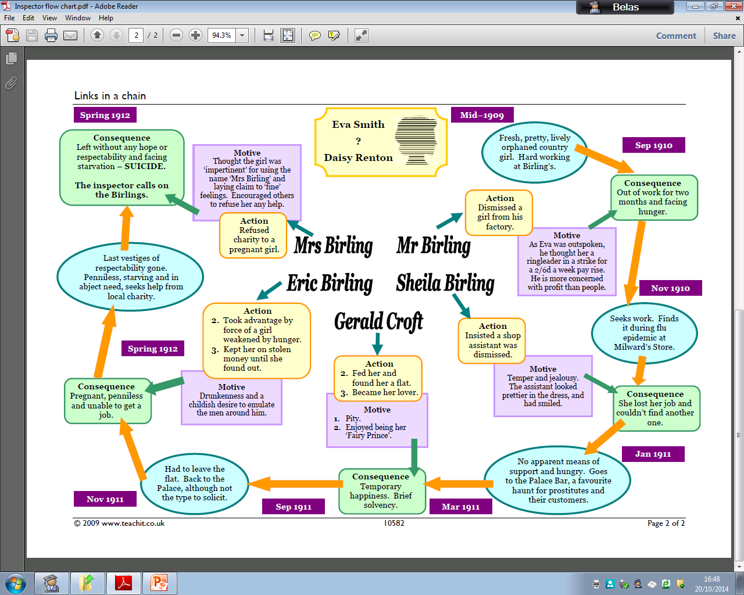

Slide 17
Task: Write a piece of short fiction based around Eva’s or Inspector Goole’s story (approx. 800 words).
Challenges
Transforming elements of the play into fiction
Choosing a narrative perspective (first/third person; past/present tense)
Developing and sustaining a narrative voice
Taking aspects of Priestley’s play and making them your own
Filling in the narrative “gaps” (details about the Inspector or Eva that Priestley never divulges)
Deciding which aspect(s) of Goole’s/Eva’s story you will use and develop

Slide 18
Eva: Which aspects of her story could we use?
Eva
Her time at the factory; her growing dissatisfaction; the loss of her job
Her job at Milwards; her being sacked by Milwards
Her affair with Gerald
Her encounter with Mrs. Birling
Her relationship with Eric; her pregnancy
Her suicide

Slide 19
Goole: How can we “turn him into” a story?
Goole
A mysterious character
A man on a moral crusade?
Genuine or phony?
How does he feel about the Birlings and people like them?
On his way to/from the Birling house
Who is he? Where does he come from? Why does he do what he does?

Slide 20
How to take Priestley’s text and adapt it
First Person
I may not be a large man, but ever since I can remember I’ve been able to… impress people. No, that’s not it: intimidate. I’m neither proud nor ashamed of this ability. But I use it. It’s necessary when you’re dealing with people like these.
Priestley’s text
“The INSPECTOR need not be a big man but he creates at once an impression of massiveness, solidity, and purposefulness.” (11)
Third Person
The Inspector was not, when you got close, a large man. But he somehow filled any room he walked into. He could command the attention of men and women who would normally think themselves far above.

Slide 21
Plan you re-creative piece

Slide 22
Planning and writing the AIC re-creative pieces
First drafts of these pieces to be in the first day back after half-term.
Today: Planning and/or writing; not wasting time!

Slide 23
First/third person?
Past/present tense?
Split narrative?
Flashback/flash-forward/linear?
Setting
No matter who you write as/about, setting may well be important; Priestley’s play is very much about how we are products of our environments/
upbringings.

Slide 24
Exercise
Write a detailed descriptive piece, focussed on setting, which uses one or more of the following pictures as a stimulus.
Write 2-3 paragraphs.

Slide 25
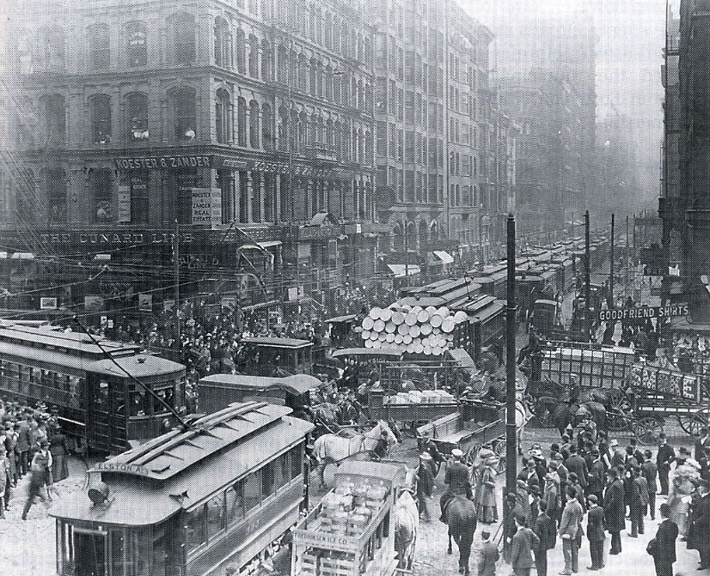
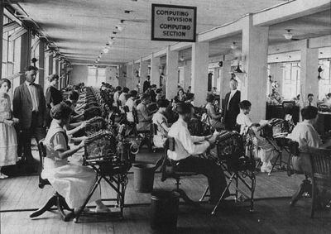
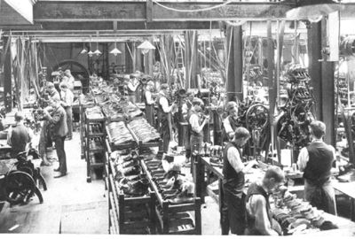
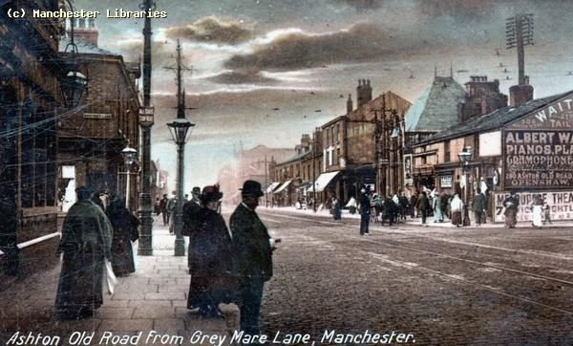

Slide 26
AIC: Revision (1)
Arthur Birling
Sybil Birling
Sheila Birling
Eric Birling
Gerald Croft
Inspector Goole
Annotate sugar paper and your copies of the text
General character traits
Quotations to support (1); include page numbers and character names
Quotations can be:
What that character says/does
What other characters say/do (about/to them)
Stage directions

Slide 27
How are Mr. and Mrs. Birling presented in An Inspector Calls?
Copy and complete the statement:
The play is set in… , but was first performed in… This is significant because…

Slide 28
The question will be about characters and/or themes. For examples:

Slide 29
Characteristics; thematic/symbolic importance
Mr. Birling
Mrs. Birling

Slide 30
Mr. Birling: opening stage directions; his predictions; attitude at the end of the play
Point | Evidence | Technique | Significance

Slide 31
Mrs. Birling: opening stage directions; his predictions; attitude at the end of the play
Point | Evidence | Technique | Significance

Slide 32
Revision groups
Goole: Molly, Lili, Saliym, Joseph, Rose
Mr. Birling: Jasmine, Lucy, Adam, Jack, Denzel
Mrs. Birling: Aishani, Emily, Courtney, Ben, Lewis
Sheila: Hindolo, Megan, Bethany, Sahan, Emerald
Eric: Harriet, Hana, Chris, Shadab, Reena
Gerald: Sena, Sarah, Millie, Ozge

Slide 33
Goole
Name – ghoul/ghost; haunts Birlings.
Won’t show photo(s) to more than one person at a time. But does this matter?
How does he describe Eva Smith? (12). But if Eva represents all working-class women, what does this description suggest?
Not intimidated (15; Birling to Goole)
Shared responsibility (29)
Who has Goole affected? (30)
Goole’s warning (56)

Slide 34
Mr. Birling
P.1) Stage direction
P.2) Speaking to Edna; Mrs. B’s response
P.4) Long speech
Pp.6-7) Predictions
P.8) Honours
Pp.14-15) Defence of his actions
Pp.56-57) Birling’s “apology” and concerns about the consequences
P.60) “Loyalty” to children
P.70) Response to the “truth” about Goole

Slide 35
Mrs. Birling
P.1: Description in opening stage direction
P.3: Expectations of/attitude towards marriage
P.2, p.4: Authority/power/status over husband
P.30-31: who has the authority figure – she is a matriarchal figure
Attempts to use status to intimidate
P. 38: Mrs. B’s authority over her daughter slipping away
P. 43: Mrs. B thinks the people – especially lower classes – should know their place
P. 44: Mrs. B shows no signs of regret or of shared guilt
Pp. 47-48: Mrs. B’s self-interest leads her unknowingly to judge her son; Sheila has worked out the “links in the chain,” but her mother has not.
P. 63: Towards end of play, Mrs. B resumes (takes back) her position of authority

Slide 36
Sheila
Opening stage direction
Page 3: dutiful wife, following her husband’s lead?
23: Individualism/collectivism? Responsibility?
24: Motivation for her actions?
34: Attitude towards “men”?
40: Change in attitude towards Gerald after truth is revealed?
41: How has Sheila’s attitude changed, mid-way in the play?
71: How has Sheila changed? What concerns her most?

Slide 37
Gerald
P. 3: Despite outward confidence, seeks reassurance from Sheila.
P. 4: Seems to share Birling’s values?
27: Does Gerald want to protect Sheila’s feelings?
P. 35: Like Goole, Gerald thinks there’s something different about Eva?
Pp.36-37: Gerald’s motivation for helping Eva/Daisy?
P. 39: Gerald beginning to “share” the “guilt”?
P. 40: How does revealing the truth affect Gerald and Sheila’s relationship?
P. 63: Does Gerald still want to “share” responsibility or “guilt”?

Slide 38
Eric: Eric absent for middle section of the play – when Sheila changes – and then central to the final act
P. 2: Stage direction
P. 3: Isolated from his family/unsure of himself
P. 4, p.6: Conflict with father/questions his father’s decisions
Pp. 14-15, 58: Questions father’s individualism & his actions
P.51: Eric’s words suggest that Eva/Daisy was not yet a prostitute – so not yet fully corrupted by social inequality
P. 52: Eric admits his selfish actions; symbolic of corruptive power of capitalism/wealth
P.53: Eric steals money from wealthy father – symbolic of socialist values of sharing wealth amongst all people
P. 55: Eric passes judgement back to his mother; family on brink of collapse
P. 57: Eric ashamed of his family and their values
P. 64: Eric and Sheila changed; they are closer/united, but now more distant from their parents & Gerald (Priestley’s belief that hope lies with the younger generation)

Slide 39
On the sugar paper:
Write a paragraph about the ways in which your character does/does not change during the play.
Include quotations and analysis
Explain the significance of words/phrases; explore what they suggest about the characters
Compare/contrast quotations from early and late in the play
Sugar paper going up next lesson

Slide 40
Inspector mock, Wednesday after half-term break
2 pages, answering the following question:
- Concentrate on detailed quotations & analysis.
Don’t retell the story
Try to offer at least two interpretations of each quotation: “The audience might interpret these words as meaning that... However, an alternative reading would be...”

